Slide 1
Scripture Reading – 1 Corinthians 13:4-7
“Love suffers long and is kind; love does not envy; love does not parade itself, is not puffed up; does not behave rudely, does not seek its own, is not provoked, thinks no evil; does not rejoice in iniquity, but rejoices in the truth; bears all things, believes all things, hopes all things, endures all things.”

Slide 2
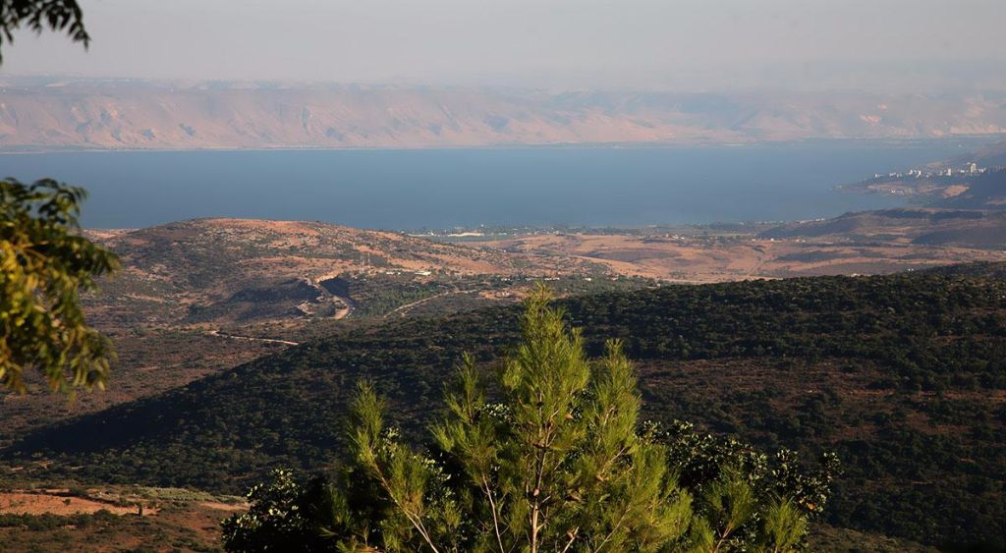
The Sermon on the Mount
Life Changing Attitudes Matthew 5:1-16
To Destroy of Fulfill? Matthew 5:17-20
Unrighteousness Begins in the Heart Matthew 5:21-48
Ruining Good by Wanting to be Seen Matthew 6:1-18
Let’s Go Treasure Hunting! Matthew 6:19-34

Slide 3
The Sermon on the Mount
“For I say to you, that unless your righteousness exceeds the righteousness of the scribes and Pharisees, you will by no means enter the kingdom of heaven.” (Matthew 5:20)
Being Ready To Help Others
Matthew 7:1-12

Slide 4
Being Ready To Help Others
Don’t Try To Be The Judge
“Judge not, that you be not judged. For with what judgment you judge, you will be judged; and with the measure you use, it will be measured back to you. And why do you look at the speck in your brother's eye, but do not consider the plank in your own eye? Or how can you say to your brother, 'Let me remove the speck from your eye'; and look, a plank is in your own eye? Hypocrite! First remove the plank from your own eye, and then you will see clearly to remove the speck from your brother's eye.” (Matthew 7:1-5)

Slide 5
Being Ready To Help Others
Don’t Try To Be The Judge
“Do not judge according to appearance, but judge with righteous judgment.”(John 7:24)
“Do not speak evil of one another, brethren. He who speaks evil of a brother and judges his brother, speaks evil of the law and judges the law. But if you judge the law, you are not a doer of the law but a judge. There is one Lawgiver, who is able to save and to destroy. Who are you to judge another?” (James 4:11-12)

Slide 6
Being Ready To Help Others
Don’t Try To Be The Judge
“Then Jesus spoke to the multitudes and to His disciples, saying: ‘The scribes and the Pharisees sit in Moses' seat. Therefore whatever they tell you to observe, that observe and do, but do not do according to their works; for they say, and do not do. For they bind heavy burdens, hard to bear, and lay them on men's shoulders; but they themselves will not move them with one of their fingers. But all their works they do to be seen by men. They make their phylacteries broad and enlarge the borders of their garments.’”
(Matthew 23:1-5)

Slide 7
Being Ready To Help Others
Don’t Try To Be The Judge
Look For The Willing
“Do not give what is holy to the dogs; nor cast your pearls before swine, lest they trample them under their feet, and turn and tear you in pieces.” (Matthew 7:6)

Slide 8
Being Ready To Help Others
Don’t Try To Be The Judge
Look For The Willing
“O Jerusalem, Jerusalem, the one who kills the prophets and stones those who are sent to her! How often I wanted to gather your children together, as a hen gathers her chicks under her wings, but you were not willing! See! Your house is left to you desolate; for I say to you, you shall see Me no more till you say, ‘BLESSED is HE WHO COMES IN THE NAME OF THE LORD!’”
(Matthew 23:37-39)

Slide 9
Being Ready To Help Others
Don’t Try To Be The Judge
Look For The Willing
“You search the Scriptures, for in them you think you have eternal life; and these are they which testify of Me. But you are not willing to come to Me that you may have life.” (John 5:39-40)

Slide 10
Being Ready To Help Others
Don’t Try To Be The Judge
Look For The Willing
Pray
“Ask, and it will be given to you; seek, and you will find; knock, and it will be opened to you. For everyone who asks receives, and he who seeks finds, and to him who knocks it will be opened. Or what man is there among you who, if his son asks for bread, will give him a stone? Or if he asks for a fish, will he give him a serpent? If you then, being evil, know how to give good gifts to your children, how much more will your Father who is in heaven give good things to those who ask Him!” (Matthew 7:7-11)

Slide 11
Being Ready To Help Others
Don’t Try To Be The Judge
Look For The Willing
Pray
“If any of you lacks wisdom, let him ask of God, who gives to all liberally and without reproach, and it will be given to him. But let him ask in faith, with no doubting, for he who doubts is like a wave of the sea driven and tossed by the wind. For let not that man suppose that he will receive anything from the Lord; he is a double-minded man, unstable in all his ways.” (James 1:5-8)

Slide 12
Being Ready To Help Others
Don’t Try To Be The Judge
Look For The Willing
Pray
“But the wisdom that is from above is first pure, then peaceable, gentle, willing to yield, full of mercy and good fruits, without partiality and without hypocrisy. Now the fruit of righteousness is sown in peace by those who make peace.”
(James 3:17-18)

Slide 13
Being Ready To Help Others
Don’t Try To Be The Judge
Look For The Willing
Pray
Truly Want To Help
“Therefore, whatever you want men to do to you, do also to them, for this is the Law and the Prophets.” (Matthew 7:12)

Slide 14
Being Ready To Help Others
Don’t Try To Be The Judge
Look For The Willing
Pray
Truly Want To Help
“Therefore, to him who knows to do good and does not do it, to him it is sin.” (James 4:17)
“And whoever of you desires to be first shall be slave of all. For even the Son of Man did not come to be served, but to serve, and to give His life a ransom for many.” (Mark 10:44-45)

Slide 15
Being Ready To Help Others
Don’t Try To Be The Judge
Look For The Willing
Pray
Truly Want To Help
“For you, brethren, have been called to liberty; only do not use liberty as an opportunity for the flesh, but through love serve one another. For all the law is fulfilled in one word, even in this: ‘YOU SHALL LOVE YOUR NEIGHBOR AS YOURSELF.’ But if you bite and devour one another, beware lest you be consumed by one another!” (Galatians 5:13-15)

Slide 16
Being Ready To Help Others
Don’t Try To Be The Judge
Look For The Willing
Pray
Truly Want To Help
Are You Equipped To Help Others?

