Slide 2
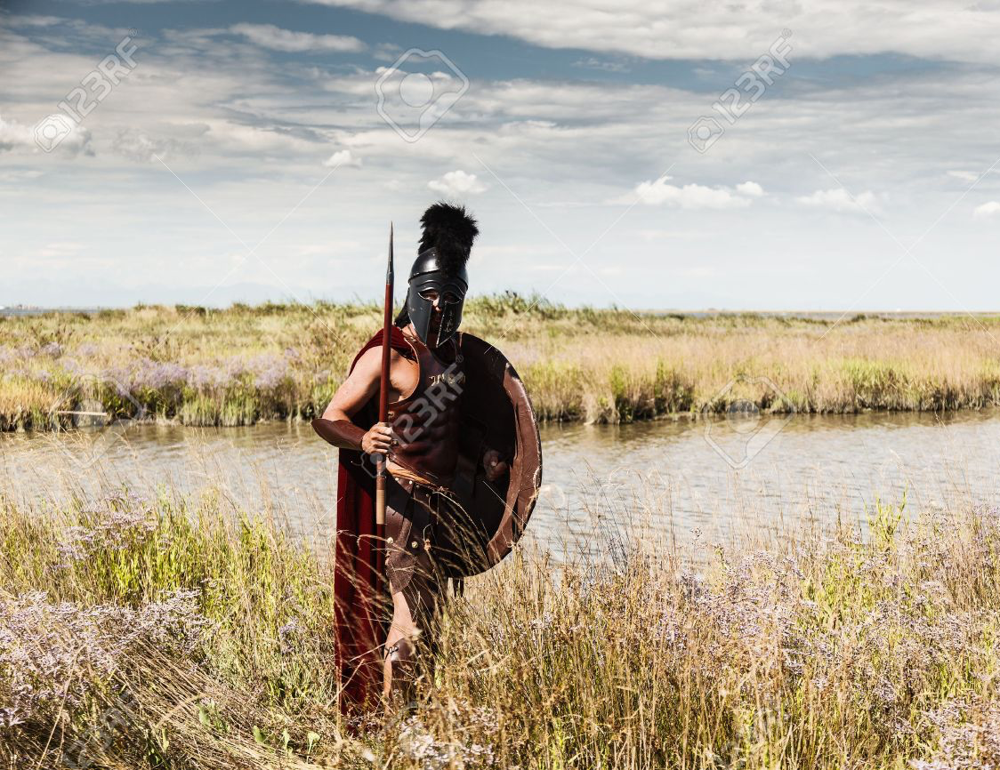
Act Like Men: Intro/Review
Matthew 19:4 male and female.
Worthy Woman (Proverbs 31:10-31)
Worthy Man (Proverbs 31:1-9)
Godly women support and demand Godly men (Germanic women illustration)
“Act like men…” (1 Corinthians 16:13)
One aspect of Biblical Manhood is man’s role as a Warrior who Protects/Preserves.

Slide 3
EVERY MAN A BRICK
The king led him down the plains, where his army was drawn up in full battle array, with their spears and their shields shining in the sunlight. Pointing to the battle lines, he said proudly to the ambassador: "There, sir, behold the walls of Sparta - Ten thousand men, and every man a brick!"

Slide 4
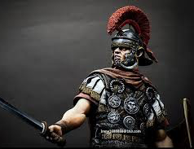
A Man Provides Physical Protection
Concept of a man’s “Sphere”
Two swords (Luke 22:35-38)
Defense of self and others.
Lay down his life (John 15:12-14)
Titus 3:1 Power under control. Not brawlers (KJV), “be peaceable” (NASB), “avoid quarreling” (ESV)

Slide 5
A Man Protects/Preserves Justice
Justice lost (Ecclesiastes 3:16-17)
Ezekiel 22:25-31 God searched for a man…
Woe to Pharisees for no justice (Matthew 23:23)
Learn to do justice. (Isaiah 1:17)
The worthy man (Proverbs 31:8-9)
Soldiers question John the Baptizer (Luke 3:14)
Justice to be given slaves (Colossians 4:1)
Injustice/partiality is sin (James 2:9, James 4:17)
A man will do what is just and fair without partiality.

Slide 6
A Man Protects/Preserves His Personal Purity
1 Timothy 4:12
Make Yourself Pure (1 John 3:2-3)
Code of honor is a wall protecting a man’s purity.
Joseph in Genesis 39:7-8 “lie with me…but he refused”. The question had already been answered before the event.
Men are not to be excused “boys will be boys”. High standard.
Self control (1 Corinthians 9:24-27)

Slide 7
A Man Protects/Preserves the Purity of Women
Song of Solomon 8:8-9
As mothers, as sisters (1 Timothy 5:2)
Not up to her to stop you, tell you no.
YOU should never put her in that position.
Be a protector. Watch for circumstances. Slippery slope.

