Slide 1
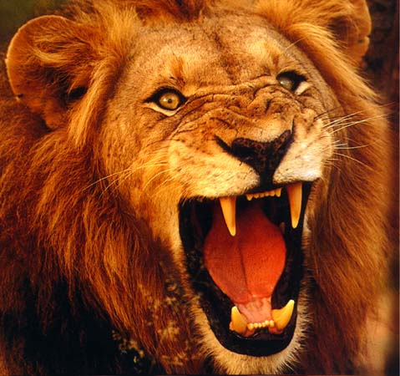
Overcoming Your Adversary
1 Peter 5:5-10

Slide 2
Overcoming Your Adversary

Slide 3
Overcoming Your Adversary
“… your adversary the devil walks about like a roaring lion, seeking whom he may devour.”
1 Peter 5:8b

Slide 4
Overcoming Your Adversary

Slide 5
Overcoming Your Adversary
Realize the Danger

Slide 6
Overcoming Your Adversary
“Likewise you younger people, submit yourselves to your elders. Yes, all of you be submissive to one another, and be clothed with humility, for ‘GOD RESISTS THE PROUD, BUT GIVES GRACE TO THE HUMBLE.’”
1 Peter 5:5
Realize the Danger

Slide 7
Overcoming Your Adversary
“Put on the whole armor of God, that you may be able to stand against the wiles of the devil.”
Ephesians 6:11
Realize the Danger

Slide 8
Overcoming Your Adversary
“And no wonder, for even Satan disguises himself as an angel of light.”
2 Corinthians 11:14
Realize the Danger

Slide 9
Overcoming Your Adversary
Realize the Danger
Get Help

Slide 10
Overcoming Your Adversary
“Therefore humble yourselves under the mighty hand of God, that He may exalt you in due time, casting all your care upon Him, for He cares for you.”
1 Peter 5:6-7
Realize the Danger
Get Help

Slide 11
Overcoming Your Adversary
“Fear not, for I am with you; be not dismayed, for I am your God; I will strengthen you, I will help you, I will uphold you with my righteous right hand.”
Isaiah 41:10
Realize the Danger
Get Help

Slide 12
Overcoming Your Adversary
“When the righteous cry for help, the Lord hears and delivers them out of all their troubles.”
Psalm 34:17
Realize the Danger
Get Help

Slide 13
Overcoming Your Adversary
“Hear, O Lord, and be merciful to me! O Lord, be my helper!”
Psalm 30:10
Realize the Danger
Get Help

Slide 14
Overcoming Your Adversary
Realize the Danger
Get Help
Be Ready

Slide 15
Overcoming Your Adversary
“Be sober, be vigilant; because your adversary the devil walks about like a roaring lion, seeking whom he may devour.
Resist him, steadfast in the faith, knowing that the same sufferings are experienced by your brotherhood in the world.”
1 Peter 5:8-9
Realize the Danger
Get Help
Be Ready

Slide 16
Overcoming Your Adversary
“As you therefore have received Christ Jesus the Lord, so walk in Him, rooted and built up in Him and established in the faith, as you have been taught, abounding in it with thanksgiving.”
Colossians 2:6-7
Realize the Danger
Get Help
Be Ready

Slide 17
Overcoming Your Adversary
“Blessed be the Lord my Rock, Who trains my hands for war, And my fingers for battle.”
Psalm 144:1
Realize the Danger
Get Help
Be Ready

Slide 18
Overcoming Your Adversary
Realize the Danger
Get Help
Be Ready
Trust God

Slide 19
Overcoming Your Adversary
“But may the God of all grace, who called us to His eternal glory by Christ Jesus, after you have suffered a while, perfect, establish, strengthen, and settle you.”
1 Peter 5:10
Realize the Danger
Get Help
Be Ready
Trust God

Slide 20
Overcoming Your Adversary
“The devil, who deceived them, was cast into the lake of fire and brimstone where the beast and the false prophet are. And they will be tormented day and night forever and ever.”
Revelation 20:10
Realize the Danger
Get Help
Be Ready
Trust God

Slide 21
Overcoming Your Adversary
“No temptation has overtaken you except such as is common to man; but God is faithful, who will not allow you to be tempted beyond what you are able, but with the temptation will also make the way of escape, that you may be able to bear it.”
1 Corinthians 10:13
Realize the Danger
Get Help
Be Ready
Trust God

Slide 22
Overcoming Your Adversary
“The Lord, who delivered me from the paw of the lion and from the paw of the bear, He will deliver me from the hand of this Philistine.”
1 Samuel 17:37
Realize the Danger
Get Help
Be Ready
Trust God

Slide 23
Overcoming Your Adversary
Realize the Danger
Get Help
Be Ready
Trust God

