Slide 1
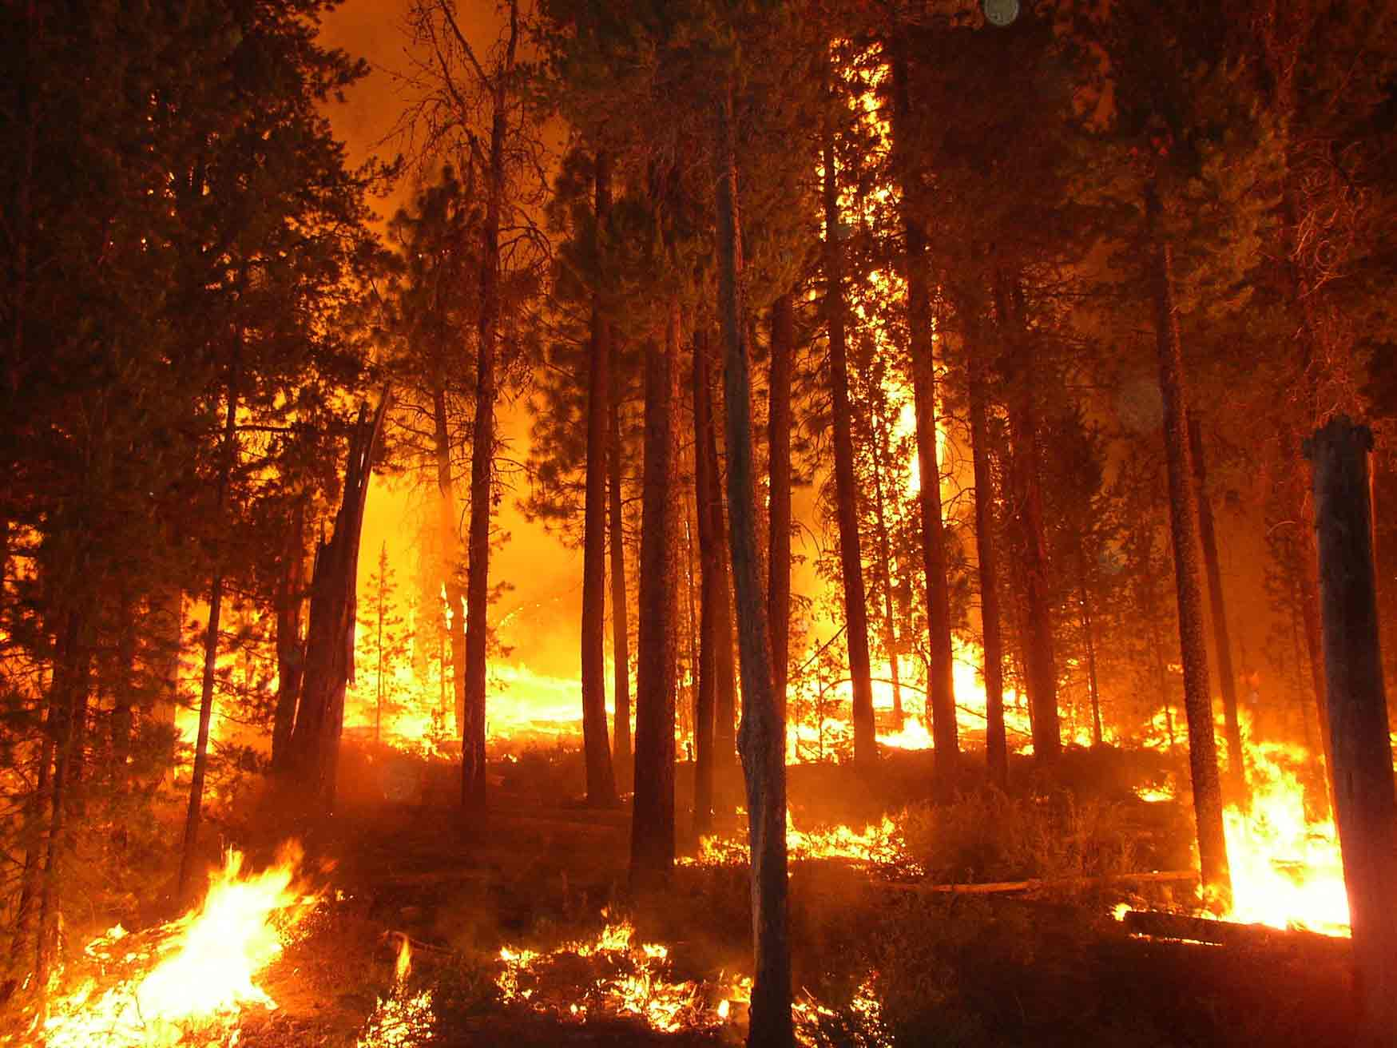
Can You Prevent Forest Fires?
Scripture Reading: Colossians 3:8-11

Slide 2
Can You Prevent Forest Fires?

Slide 3
Can You Prevent Forest Fires?
“Even so the tongue is a little member and boasts great things. See how great a forest a little fire kindles! And the tongue is a fire, a world of iniquity. The tongue is so set among our members that it defiles the whole body, and sets on fire the course of nature; and it is set on fire by hell.” James 3:5-6

Slide 4
Can You Prevent Forest Fires?

Slide 5
Can You Prevent Forest Fires?
James 3:1-12

Slide 6
Can You Prevent Forest Fires?

Slide 7
Can You Prevent Forest Fires?
Do Not Lie

Slide 8
Can You Prevent Forest Fires?
Do Not Lie
Ephesians 4:25-31

Slide 9
Can You Prevent Forest Fires?
Do Not Lie
“But there shall by no means enter it anything that defiles, or causes an abomination or a lie, but only those who are written in the Lamb's Book of Life.”
Revelation 21:27

Slide 10
Can You Prevent Forest Fires?
Do Not Lie
“You are of your father the devil, and the desires of your father you want to do. He was a murderer from the beginning, and does not stand in the truth, because there is no truth in him. When he speaks a lie, he speaks from his own resources, for he is a liar and the father of it.” John 8:44

Slide 11
Can You Prevent Forest Fires?
Do Not Lie

Slide 12
Can You Prevent Forest Fires?
Do Not Lie
Eliminate Filthy Language

Slide 13
Can You Prevent Forest Fires?
Eliminate Filthy Language

Slide 14
Can You Prevent Forest Fires?
Eliminate Filthy Language
“But now you yourselves are to put off all these: anger, wrath, malice, blasphemy, filthy language out of your mouth.” Colossians 3:8

Slide 15
Can You Prevent Forest Fires?
Eliminate Filthy Language
“Let no corrupt word proceed out of your mouth, but what is good for necessary edification, that it may impart grace to the hearers.”
Ephesians 4:29

Slide 16
Can You Prevent Forest Fires?
Eliminate Filthy Language
“But fornication and all uncleanness or covetousness, let it not even be named among you, as is fitting for saints; neither filthiness, nor foolish talking, nor coarse jesting, which are not fitting, but rather giving of thanks.”
Ephesians 5:3-4

Slide 17
Can You Prevent Forest Fires?
Eliminate Filthy Language
“You shall not take the name of the Lord your God in vain, for the Lord will not hold him guiltless who takes His name in vain.”
Exodus 20:7

Slide 18
Can You Prevent Forest Fires?
Do Not Lie
Eliminate Filthy Language

Slide 19
Can You Prevent Forest Fires?
Do Not Lie
Eliminate Filthy Language
Neither Speak Nor Listen To Gossip

Slide 20
Can You Prevent Forest Fires?
Neither Speak Nor Listen To Gossip

Slide 21
Can You Prevent Forest Fires?
Neither Speak Nor Listen To Gossip
“Where there is no wood, the fire goes out; And where there is no talebearer, strife ceases. As charcoal is to burning coals, and wood to fire, So is a contentious man to kindle strife. The words of a talebearer are like tasty trifles, And they go down into the inmost body.”
Proverbs 26:20-22

Slide 22
Can You Prevent Forest Fires?
Neither Speak Nor Listen To Gossip
“… being filled with all unrighteousness, sexual immorality, wickedness, covetousness, maliciousness; full of envy, murder, strife, deceit, evil-mindedness; they are whisperers, backbiters, haters of God, violent, proud, boasters, inventors of evil things, disobedient to parents …”
Romans 1:29-30

Slide 23
Can You Prevent Forest Fires?
Neither Speak Nor Listen To Gossip
“If anyone among you thinks he is religious, and does not bridle his tongue but deceives his own heart, this one's religion is useless.”
James 1:26

Slide 24
Can You Prevent Forest Fires?
Neither Speak Nor Listen To Gossip
“An evildoer gives heed to false lips; A liar listens eagerly to a spiteful tongue.”
Proverbs 17:4

Slide 25
Can You Prevent Forest Fires?
Neither Speak Nor Listen To Gossip
“He who covers a transgression seeks love, But he who repeats a matter separates friends.”
Proverbs 17:9

Slide 26
Can You Prevent Forest Fires?
Do Not Lie
Eliminate Filthy Language
Neither Speak Nor Listen To Gossip

Slide 27
Can You Prevent Forest Fires?
Do Not Lie
Eliminate Filthy Language
Neither Speak Nor Listen To Gossip
Speak Good Things

Slide 28
Can You Prevent Forest Fires?
Speak Good Things

Slide 29
Can You Prevent Forest Fires?
Speak Good Things
“Have I not commanded you? Be strong and of good courage; do not be afraid, nor be dismayed, for the Lord your God is with you wherever you go”
Joshua 1:9

Slide 30
Can You Prevent Forest Fires?
Speak Good Things
“And with many other words he testified and exhorted them, saying, ‘Be saved from this perverse generation.’”
Acts 2:40

Slide 31
Can You Prevent Forest Fires?
Speak Good Things
“These things I have spoken to you, that in Me you may have peace. In the world you will have tribulation; but be of good cheer, I have overcome the world.’”
John 16:33

Slide 32
Can You Prevent Forest Fires?
Do Not Lie
Eliminate Filthy Language
Neither Speak Nor Listen To Gossip
Speak Good Things

Slide 33
Can You Prevent Forest Fires?

