Slide 1
Building Defenses
Against Sexual Sin
"And everyone who has this hope fixed on Him purifies himself, just as He is pure." (1 John 3:3)

Slide 2
What is "Fornication"?
Plain definition of NT “porneia” (Greek)
Sexual activity between people not scripturally married to one another. "
Includes the unmarried, married but not to each other, lesbianism, homosexuality, incest, etc…
Variously Translated "fornication", "sexual immorality", "immorality", "unchasity"

Slide 3
So How Do We Build Defenses Against Sexual Sin?

Slide 4
#1: The Proper Attitude About Fornication
First, Realize how serious it is…
"Flee immorality. Every other sin that a man commits is outside the body, but the immoral man sins against his own body."
(1 Corinthians 6:18)

Slide 5
#1: The Proper Attitude About Fornication
First, Realize how serious it is…
"Marriage is to be held in honor among all, and the marriage bed is to be undefiled; for fornicators and adulterers God will judge."
(Hebrews 13:4)

Slide 6
#1: The Proper Attitude About Fornication
First, Realize how serious it is…
"19 Now the deeds of the flesh are evident, which are: immorality, impurity, sensuality… 21… of which I forewarn you, just as I have forewarned you, that those who practice such things will not inherit the kingdom of God." (Galatians 5:19-21)

Slide 7
#1: The Proper Attitude About Fornication
Second, Realize it's something we need to Flee!
Some things are so dangerous we need to run from them!
"Flee immorality."
(1 Corinthians 6:18)
"Flee from youthful lusts…" (2 Timothy 2:22)

Slide 8
#1: The Proper Attitude About Fornication
Third, Realize it means Capture, Destruction, Slaughter and Death!
"For on account of a harlot one is reduced to a loaf of bread,
And an adulteress hunts for the precious life." (Proverbs 6:26)

Slide 9
#1: The Proper Attitude About Fornication
Third, Realize it means Capture, Destruction, Slaughter and Death!
"The one who commits adultery with a woman is lacking sense;
He who would destroy himself does it." (Proverbs 6:32)

Slide 10
#1: The Proper Attitude About Fornication
Third, Realize it means Capture, Destruction, Slaughter and Death!
"Suddenly he follows her
As an ox goes to the slaughter,
Or as one in fetters to the discipline of a fool," (Proverbs 7:22)

Slide 11
#1: The Proper Attitude About Fornication
Third, Realize it means Capture, Destruction, Slaughter and Death!
"25 Do not let your heart turn aside to her ways, Do not stray into her paths. 26 For many are the victims she has cast down, And numerous are all her slain. 27 Her house is the way to Sheol, Descending to the chambers of death." (Proverbs 7:25-27)

Slide 12
#1: The Proper Attitude About Fornication
In Summary….
Realize it's something we need to Flee!
Realize how serious it is…
Realize it means Capture, Destruction, Slaughter and Death!

Slide 13
#2: Be Content with God’s Way
“Do not desire her beauty…” (Proverbs 6:25)
Be satisfied with your spouse (Proverbs 5:15-19)

Slide 14
Proverbs 5:15-19
"15 Drink water from your own cistern
And fresh water from your own well.
16 Should your springs be dispersed abroad,
Streams of water in the streets?
17 Let them be yours alone
And not for strangers with you.
18 Let your fountain be blessed,
And rejoice in the wife of your youth.
19 As a loving hind and a graceful doe,
Let her breasts satisfy you at all times;
Be exhilarated always with her love."

Slide 15
#2: Be Content with God’s Way
Marriage bed honorable…
"Marriage is to be held in honor among all, and the marriage bed is to be undefiled; for fornicators and adulterers God will judge." (Hebrews 13:4)

Slide 16
#3: Commit to Education and Training
A process of learning and training, like learning a sport, new skill such as sewing or cooking, hunt/fish…. Or how to drive a car…
Knowing how things “work”

Slide 17
#3: Commit to Education and Training
Uneducated/untrained person… their end is destruction!
“6 For at the window of my house I looked out through my lattice,
7 And I saw among the naïve, And discerned among the youths
A young man lacking sense,” (Proverbs 7:6-7)

Slide 18
#3: Commit to Education and Training
Progression in Training…
Directed…
Led…
Walk…
Run…
“10 Hear, my son, and accept my sayings And the years of your life will be many. 11 I have directed you in the way of wisdom; I have led you in upright paths. 12 When you walk, your steps will not be impeded; And if you run, you will not stumble. 13 Take hold of instruction; do not let go. Guard her, for she is your life.” (Proverbs 4:10-13)

Slide 19
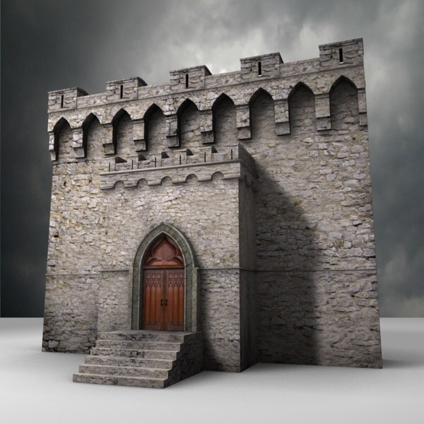
#3: Commit to Education and Training
Wisdom and training informs, enlightens and guides.
Proverbs 7:10-21
The trained can recognize situations/schemes

Slide 20
Proverbs 7:10-21
10 And behold, a woman comes to meet him,
Dressed as a harlot and cunning of heart.
11 She is boisterous and rebellious,
Her feet do not remain at home;
12 She is now in the streets, now in the squares,
And lurks by every corner.
13 So she seizes him and kisses him
And with a brazen face she says to him:

Slide 21
Proverbs 7:10-21 (continued…)
14 “I was due to offer peace offerings;
Today I have paid my vows.
15 “Therefore I have come out to meet you,
To seek your presence earnestly, and I have found you.
16 “I have spread my couch with coverings,
With colored linens of Egypt.
17 “I have sprinkled my bed
With myrrh, aloes and cinnamon.

Slide 22
Proverbs 7:10-21 (continued…)
18 “Come, let us drink our fill of love until morning;
Let us delight ourselves with caresses.
19 “For my husband is not at home,
He has gone on a long journey;
20 He has taken a bag of money with him,
At the full moon he will come home.”
21 With her many persuasions she entices him;
With her flattering lips she seduces him.

Slide 23
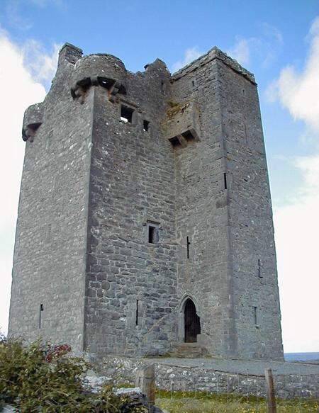
#4: Appreciate the Value of Wisdom
Not just knowledge, but education and training applied.
Proverbs 6:22-24

Slide 24
Proverbs 6:22-24
22 When you walk about, they will guide you;
When you sleep, they will watch over you;
And when you awake, they will talk to you.
23 For the commandment is a lamp and the teaching is light;
And reproofs for discipline are the way of life
24 To keep you from the evil woman,
From the smooth tongue of the adulteress.

Slide 25
#4: Appreciate the Value of Wisdom
“Say to wisdom you are my sister” (Proverbs 7:1-5)

Slide 26
Proverbs 7:1-5
1 My son, keep my words
And treasure my commandments within you.
2 Keep my commandments and live,
And my teaching as the apple of your eye.
3 Bind them on your fingers;
Write them on the tablet of your heart.
4 Say to wisdom, “You are my sister,”
And call understanding your intimate friend;
5 That they may keep you from an adulteress,
From the foreigner who flatters with her words.

Slide 27
#5: Avoidance is God’s First Plan…
Make it Your Plan Too!
"To keep you from the evil woman, From the smooth tongue of the adulteress." (Proverbs 6:24)
"Now therefore, my sons, listen to me, And pay attention to the words of my mouth. Do not let your heart turn aside to her ways, Do not stray into her paths." (Proverbs 7:24-25)
"Keep your way far from her, And do not go near the door of her house," (Proverbs 5:8)

Slide 28
#6: Run Away if Needed…
Don't be Afraid to Run!
“Flee” (as reference earlier)
Joseph (Genesis 39:12)
"She caught him by his garment, saying, “Lie with me!” And he left his garment in her hand and fled, and went outside."

Slide 29
#7: A Change in Tactics (Actions)
Suggestions…
Might need to stay away from certain people.
(“keep from…”)
Might need to stay away from certain situations.
Might need to stop activities that “feed” the problem

Slide 30
#7: A Change in Tactics (Actions)
Stop trying to see “how close can I get?”
Proverbs 7:8 “passes near” "takes the way"
Proverbs 7:9 looks for opportunities
"8 Passing through the street near her corner;
And he takes the way to her house,
9 In the twilight, in the evening,
In the middle of the night and in the darkness." (Proverbs 7:8-9)

Slide 31
#7: A Change in Tactics (Actions)
Stop trying to see “how close can I get?”
Sexual flirting…
"Petting" (Hands where they have no right to be…)
Heavy emphasis on physical affection in a dating relationship.

Slide 32
#7: A Change in Tactics (Actions)
Soul searching questions…
Does the way you dress attract people interested in fornication?
Does the way you talk attract people interested in fornication?
Does the way you act attract people interested in fornication?

Slide 33
#8: A Change in Strategy (Thinking)
Stop Thinking No consequences (I can “get away” with it)
Proverbs 6:27-35

Slide 34
Proverbs 6:27-35
27 Can a man take fire in his bosom
And his clothes not be burned?
28 Or can a man walk on hot coals
And his feet not be scorched?
29 So is the one who goes in to his neighbor’s wife;
Whoever touches her will not go unpunished.
30 Men do not despise a thief if he steals
To satisfy himself when he is hungry;
31 But when he is found, he must repay sevenfold;
He must give all the substance of his house.

Slide 35
Proverbs 6:27-35 (continued…)
32 The one who commits adultery with a woman is lacking sense;
He who would destroy himself does it.
33 Wounds and disgrace he will find,
And his reproach will not be blotted out.
34 For jealousy enrages a man,
And he will not spare in the day of vengeance.
35 He will not accept any ransom,
Nor will he be satisfied though you give many gifts.

Slide 36
#8: A Change in Strategy (Thinking)
Stop Thinking No consequences (I can “get away” with it)
Proverbs 7:22-23

Slide 37
Proverbs 7:22-23
22 Suddenly he follows her
As an ox goes to the slaughter,
Or as one in fetters to the discipline of a fool,
23 Until an arrow pierces through his liver;
As a bird hastens to the snare,
So he does not know that it will cost him his life.

Slide 38
#8: A Change in Strategy (Thinking)
Stop dwelling on sexual thoughts…
Pornography
Going places where immodesty is common in order to look and think impure thoughts.
Viewing men/woman as sexual objects.

Slide 39
#8: A Change in Strategy (Thinking)
Improper Attitudes…
Everyone else is doing it…
“Enter through the narrow gate; for the gate is wide and the way is broad that leads to destruction, and there are many who enter through it." (Matthew 7:13)

Slide 40
#8: A Change in Strategy (Thinking)
Improper Attitudes…
I Can look as long as I don't touch…
"I say to you that everyone who looks at a woman with lust for her has already committed adultery with her in his heart." (Matthew 5:28)

Slide 41
#8: A Change in Strategy (Thinking)
Improper Attitudes…
No one will know. I can appear pure in public, but impure in private as long as no one knows.
"For God will bring every act to judgment, everything which is hidden, whether it is good or evil." (Ecclesiastes 12:14)

Slide 42
#8: A Change in Strategy (Thinking)
Improper Attitudes…
If we “love” each other it's ok…
NO… It's not… It's SIN.
"… fornicators and adulterers God will judge." (Hebrews 13:4)

Slide 43
#8: A Change in Strategy (Thinking)
Improper Attitudes…
I can't resist…
"No temptation has overtaken you but such as is common to man; and God is faithful, who will not allow you to be tempted beyond what you are able, but with the temptation will provide the way of escape also, so that you will be able to endure it." (1 Corinthians 10:13)

Slide 44
Concluding Passage
Behave properly.. and make no “Provision for the flesh”
"13 Let us behave properly as in the day, not in carousing and drunkenness, not in sexual promiscuity and sensuality, not in strife and jealousy. 14 But put on the Lord Jesus Christ, and make no provision for the flesh in regard to its lusts." (Romans 13:13-14)

