Slide 1
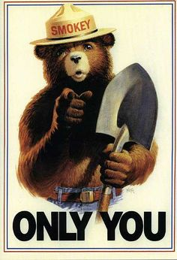
Can Prevent Forest Fires

Slide 2
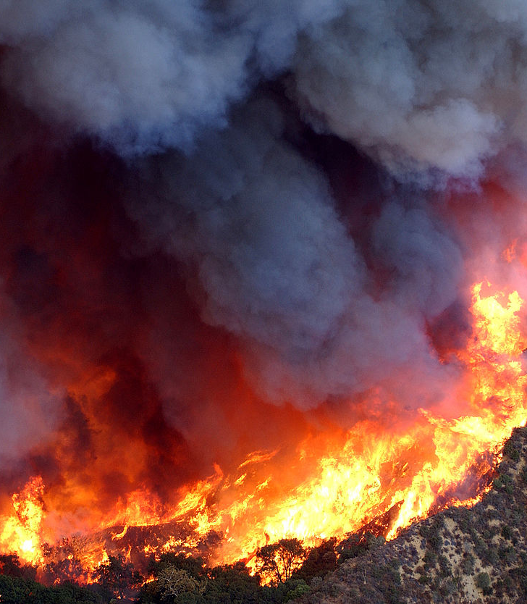
Cause:
Large Campfire
The Rim fire began August 17th, 2013, when hunter started an illegal campfire during California’s wildfire season. The blaze leveled more than 240,000 acres, destroying homes and property to the tune of $127,000,000. Due to a lack of winter rains, some logs smoldered in the interior portion of the forest throughout the winter. The fire burned for almost a year before being declared put out.

Slide 3
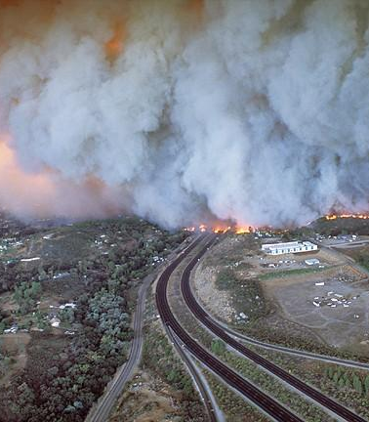
Cause:
Something A little Smaller…..
The San Diego Cedar Fire- This blaze that began after a lost hunter lit a small signal fire in the Cleveland National Forest, just 25 miles from San Diego. It consumed more than 280,000 acres — almost 30,000 of which were within the city limits of San Diego — This was the largest single fire in California's recorded history. It could be seen from outer space…

Slide 4
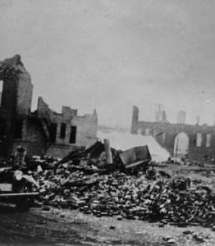
Cause:
Something even smaller still…..
Minnesota’s worst Natural disaster, the Cloquet Fire of 1918, claimed close to 500 lives in a single day. The fire began after sparks from local railroad tracks ignited dry brush. By the time the fire subsided, almost 38 communities were burned to the ground, 250,000 acres laid waste, 52,000 left injured or homeless and the costs mounted to nearly $75 million…. in 1918 money.

Slide 5
Other Small Things That start Fires
James 3: 2, 5-12
2 For we all stumble in many ways. And if anyone does not stumble in what he says, he is a perfect man, able also to bridle his whole body.
⁵ So also the tongue is a small member, yet it boasts of great things. How great a forest is set ablaze by such a small fire! ⁶ And the tongue is a fire, a world of unrighteousness. The tongue is set among our members, staining the whole body, setting on fire the entire course of life, and set on fire by hell. ⁷ For every kind of beast and bird, of reptile and sea creature, can be tamed and has been tamed by mankind, ⁸ but no human being can tame the tongue. It is a restless evil, full of deadly poison. ⁹ With it we bless our Lord and Father, and with it we curse people who are made in the likeness of God. ¹⁰ From the same mouth come blessing and cursing. My brothers, these things ought not to be so. ¹¹ Does a spring pour forth from the same opening both fresh and salt water? ¹² Can a fig tree, my brothers, bear olives, or a grapevine produce figs? Neither can a salt pond yield fresh water.

Slide 6
The tongue is small, but….
It is described as a fire, A world of unrighteousness V.6
It sets on fire THE ENTIRE COURSE OF LIFE, set on fire by hell.
The kind of damage cannot always be measured in property lost or money spent.
It can consume us all at some point in time. DO NOT BE FOOLED or let you guard down. The tongue can be an edifier and encourager, or it can destroy friendships, families, and even congregations.

Slide 7
Our words can :
The Bad News:
The Good News:
Tear down a congregation. Ephesians 4:29-31
Drive the lost further from Christ. James 1:26
Destroy confidence of family and friends
Bring divisions amongst our group (cliques), divide those who should care for one another against each other. Proverbs 17:9
Building up a congregation. 1 Thessalonians 5:11-14
Encouraging others to seek after Christ. Colossians 1:8
Boost confidence in Family and friends
Bringing people closer together. Ecclesiastes 4: 9-10

Slide 8
What are you doing?
Starting Fires
-OR-
Spreading Good News

Slide 9
A special danger to young folks:
You world is especially filled with temptation
Facebook
Social Media Sites
Desire to fit in, be popular, surrounded by it at school, sporting events, etc.
DO NOT BECOME CLIQUE-ISH
It can happen here…. Be better than that.

Slide 10
Danger to US older folks:
Tendency to get older and become more cynical (“get off my Lawn!”)
To forget what it was like to be young-approach situation without compassionate words and understanding
The “Well back in my day…”
DON’T GET CROTCHETY!
It has happened here… I have done it.

Slide 11
Take Aways:
Wild Fires:
Wild Words:
A fire can start anytime, but sometimes there are conditions that can contribute to causing a lot more damage.
The amount of damage caused isn’t always related to the size of what started the fire in the first place.
Although very difficult to contain after they have started, think of the damage it would cause if the effort was not put forth to put it out.
We must be careful what we say and how; the damage caused can be quite hurtful
Even small gossip or hurtful words can cause great amounts of damage
It is hard to contain our thoughts sometimes, but if we don’t even try- we will hurt a lot of people we care about.

Slide 12
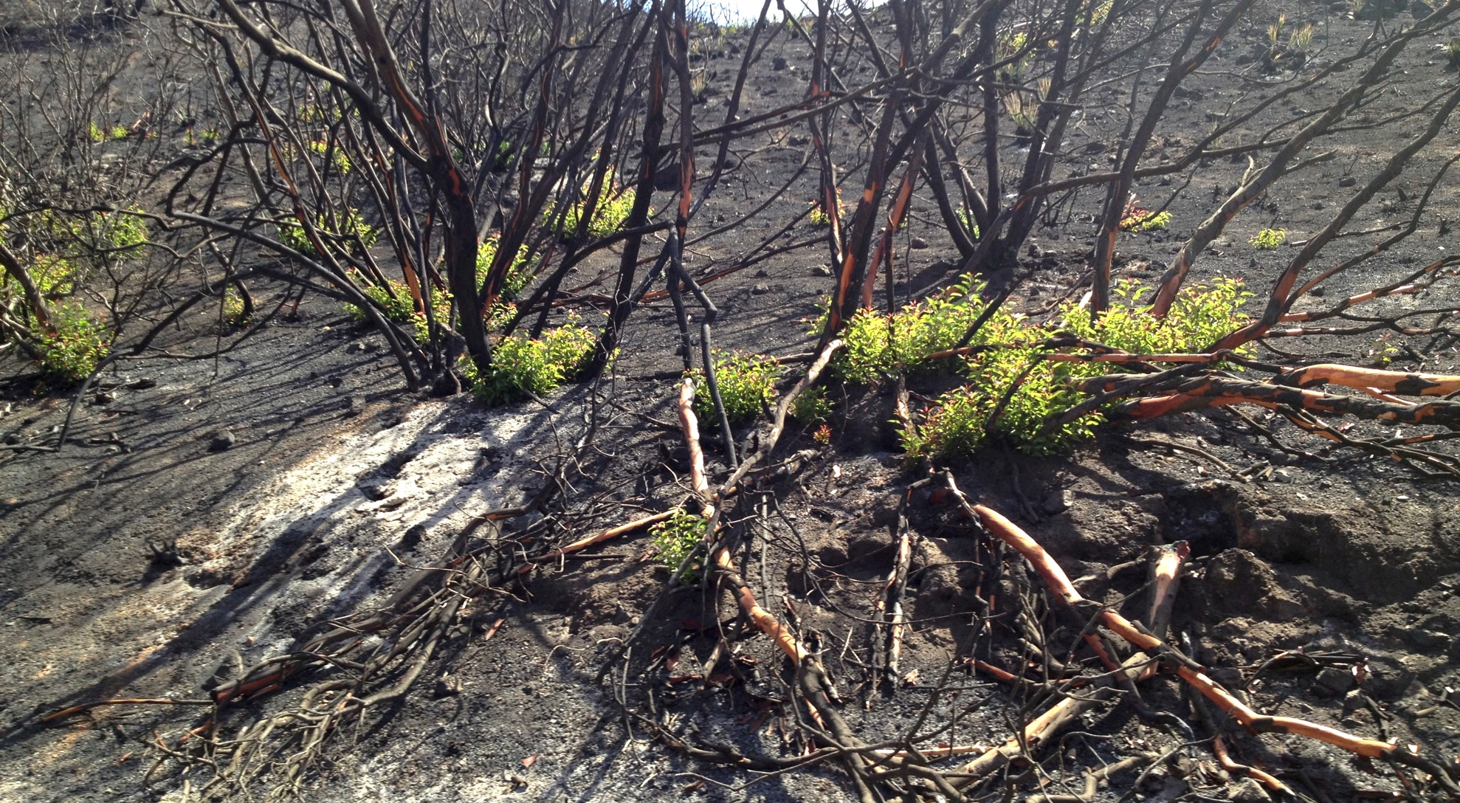
Even after a devastating fire, Life can begin a fresh start..

Slide 13
Don’t go through your life with a fire still burning.
Don’t be a fire starter
Don’t be like the Liar and the Accuser
Put away the arguments, disagreements, backbiting, and the gossip
Rekindle old friendships
Use only kind words tempered with love
If YOU see a fire starting- PUT IT OUT!!
BE LIKE CHRIST!

Slide 14
And Remember…..

