Slide 1
Controlling Anger
Scripture Reading:
“Be angry and do not sin; do not let the sun go down on your anger, and give no opportunity to the devil.” (Ephesians 4:26-27)

Slide 2
Controlling Anger
Ephesians 4:26-27

Slide 3
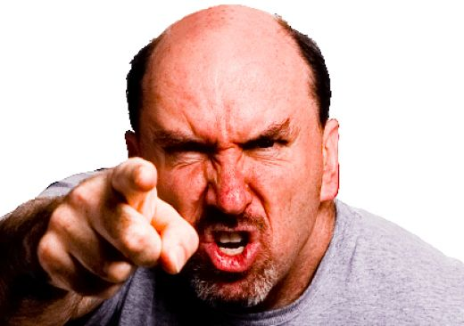
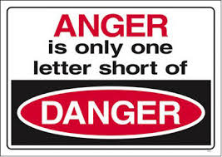
Controlling Anger

Slide 4
Controlling Anger
Be Angry
“Be angry and do not sin; do not let the sun go down on your anger, and give no opportunity to the devil.” (Ephesians 4:26-27)

Slide 5
Controlling Anger
Be Angry
“And with whom was he provoked for forty years? Was it not with those who sinned, whose bodies fell in the wilderness?” (Hebrews 3:17)

Slide 6
Controlling Anger
Be Angry
“God is a righteous judge, and a God who feels indignation every day.” (Psalm 7:11)

Slide 7
Controlling Anger
Be Angry
Don’t Sin

Slide 8
Controlling Anger
Don’t Sin
“Be angry and do not sin; do not let the sun go down on your anger, and give no opportunity to the devil.” (Ephesians 4:26-27)

Slide 9
Controlling Anger
Don’t Sin
“... So Cain was very angry … The LORD said to Cain, "Why are you angry, and why has your face fallen? If you do well, will you not be accepted? And if you do not do well, sin is crouching at the door. Its desire is for you, but you must rule over it." Cain spoke to Abel his brother. And when they were in the field, Cain rose up against his brother Abel and killed him.” (Genesis 4:5-8)

Slide 10
Controlling Anger
Don’t Sin
“But I say to you that everyone who is angry with his brother will be liable to judgment; whoever insults his brother will be liable to the council; and whoever says, 'You fool!' will be liable to the hell of fire.” (Matthew 5:22)

Slide 11
Controlling Anger
Be Angry
Don’t Sin
Keep Control

Slide 12
Controlling Anger
Keep Control
“Be angry and do not sin; do not let the sun go down on your anger, and give no opportunity to the devil.” (Ephesians 4:26-27)

Slide 13
Controlling Anger
Keep Control
“Know this, my beloved brothers: let every person be quick to hear, slow to speak, slow to anger; for the anger of man does not produce the righteousness of God.” (James 1:19-20)

Slide 14
Controlling Anger
Keep Control
“But now you must put them all away: anger, wrath, malice, slander, and obscene talk from your mouth.” (Colossians 3:8)

Slide 15
Controlling Anger
Be Angry
Don’t Sin
Keep Control
Realize the Danger

Slide 16
Controlling Anger
Realize the Danger
“Be angry and do not sin; do not let the sun go down on your anger, and give no opportunity to the devil.” (Ephesians 4:26-27)

Slide 17
Controlling Anger
Realize the Danger
“Be not quick in your spirit to become angry, for anger lodges in the heart of fools.” (Ecclesiastes 7:9)

Slide 18
Controlling Anger
Realize the Danger
“One who is wise is cautious and turns away from evil, but a fool is reckless and careless. A man of quick temper acts foolishly, and a man of evil devices is hated.” (Proverbs 14:16-17)

Slide 19
Controlling Anger
Be Angry
Don’t Sin
Keep Control
Realize the Danger

