Slide 1
Scripture Reading: Genesis 38:27-30
“Now it came to pass, at the time for giving birth, that behold, twins were in her womb. And so it was, when she was giving birth, that the one put out his hand; and the midwife took a scarlet thread and bound it on his hand, saying, ‘This one came out first.’ Then it happened, as he drew back his hand, that his brother came out unexpectedly; and she said, ‘How did you break through? This breach be upon you!’ Therefore his name was called Perez. Afterward his brother came out who had the scarlet thread on his hand. And his name was called Zerah.”

Slide 2
Do You Have an Identical Twin?
Someone who looks just like you but …

Slide 3
Do You Have An Identical Twin? Someone who looks just like you but couldn’t be you because…
The Way They Dress
“… likewise also that women should adorn themselves in respectable apparel, with modesty and self-control, not with braided hair and gold or pearls or costly attire, but with what is proper for women who profess godliness—with good works.” (1 Timothy 2:9-10)
“Do not let your adorning be external—the braiding of hair and the putting on of gold jewelry, or the clothing you wear—but let your adorning be the hidden person of the heart with the imperishable beauty of a gentle and quiet spirit, which in God's sight is very precious.” (1 Peter 3:3-4)

Slide 4
Do You Have An Identical Twin? Someone who looks just like you but couldn’t be you because…
The Way They Dress
The Way They Talk

Slide 5
Do You Have An Identical Twin? Someone who looks just like you but couldn’t be you because…
The Way They Talk
“Let no corrupting talk come out of your mouths, but only such as is good for building up, as fits the occasion, that it may give grace to those who hear.” (Ephesians 4:29)
“From the same mouth come blessing and cursing. My brothers, these things ought not to be so.” (James 3:10)

Slide 6
Do You Have An Identical Twin? Someone who looks just like you but couldn’t be you because…
The Way They Dress
The Way They Talk
The Places They Go

Slide 7
Do You Have An Identical Twin? Someone who looks just like you but couldn’t be you because…
The Places They Go
“You are the salt of the earth, but if salt has lost its taste, how shall its saltiness be restored? It is no longer good for anything except to be thrown out and trampled under people's feet.” (Matthew 5:13)
“Do not be deceived: ‘Bad company ruins good morals.’” (1 Corinthians 15:33)

Slide 8
Do You Have An Identical Twin? Someone who looks just like you but couldn’t be you because…
The Way They Dress
The Way They Talk
The Places They Go
The Entertainment They Watch

Slide 9
Do You Have An Identical Twin? Someone who looks just like you but couldn’t be you because…
The Entertainment They Watch
“I will not set before my eyes anything that is worthless. I hate the work of those who fall away; it shall not cling to me.” (Psalm 101:3)
“Finally, brothers, whatever is true, whatever is honorable, whatever is just, whatever is pure, whatever is lovely, whatever is commendable, if there is any excellence, if there is anything worthy of praise, think about these things. What you have learned and received and heard and seen in me—practice these things, and the God of peace will be with you.” (Philippians 4:8-9)

Slide 10
Do You Have An Identical Twin? Someone who looks just like you but couldn’t be you because…
The Way They Dress
The Way They Talk
The Places They Go
The Entertainment They Watch
They Get Intoxicated

Slide 11
Do You Have An Identical Twin? Someone who looks just like you but couldn’t be you because…
They Get Intoxicated
“And do not get drunk with wine, for that is debauchery, but be filled with the Spirit …” (Ephesians 5:18)
“Wine is a mocker, strong drink a brawler, and whoever is led astray by it is not wise.” (Proverbs 20:1)

Slide 12
Do You Have An Identical Twin? Someone who looks just like you but couldn’t be you because…
The Way They Dress
The Way They Talk
The Places They Go
The Entertainment They Watch
They Get Intoxicated
Their Unchaste Conduct

Slide 13
Do You Have An Identical Twin? Someone who looks just like you but couldn’t be you because…
Their Unchaste Conduct
“Let marriage be held in honor among all, and let the marriage bed be undefiled, for God will judge the sexually immoral and adulterous.” (Hebrews 13:4)
“Flee from sexual immorality. Every other sin a person commits is outside the body, but the sexually immoral person sins against his own body. Or do you not know that your body is a temple of the Holy Spirit within you, whom you have from God? You are not your own, for you were bought with a price. So glorify God in your body.” (1 Corinthians 6:18-20)

Slide 14
Do You Have An Identical Twin? Someone who looks just like you but couldn’t be you because…
The Way They Dress
The Way They Talk
The Places They Go
The Entertainment They Watch
They Get Intoxicated
Their Unchaste Conduct
The Things They Post On Social Media

Slide 15
Do You Have An Identical Twin? Someone who looks just like you but couldn’t be you because…
The Things They Post On Social Media
“I have been crucified with Christ. It is no longer I who live, but Christ who lives in me. And the life I now live in the flesh I live by faith in the Son of God, who loved me and gave himself for me.” (Galatians 2:20)
“I therefore, a prisoner for the Lord, urge you to walk in a manner worthy of the calling to which you have been called, with all humility and gentleness, with patience, bearing with one another in love, eager to maintain the unity of the Spirit in the bond of peace.” (Ephesians 4:1-3)

Slide 16
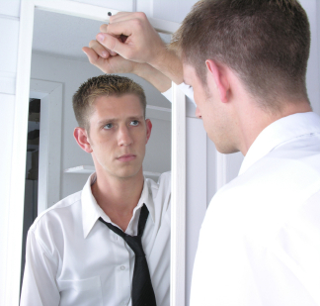
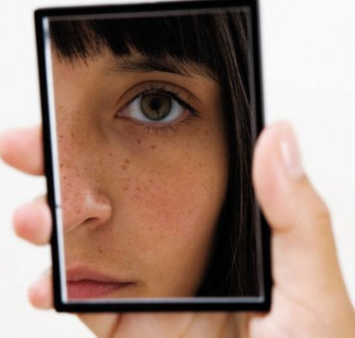
Do You Have An Identical Twin? Someone who looks just like you but couldn’t be you because…
The Way They Dress
The Way They Talk
The Places They Go
The Entertainment They Watch
They Get Intoxicated
Their Unchaste Conduct
The Things They Post On Social Media

