Slide 1
Scripture Reading – James 1:12-15
“Blessed is the man who endures temptation; for when he has been approved, he will receive the crown of life which the Lord has promised to those who love Him. Let no one say when he is tempted, "I am tempted by God"; for God cannot be tempted by evil, nor does He Himself tempt anyone. But each one is tempted when he is drawn away by his own desires and enticed. Then, when desire has conceived, it gives birth to sin; and sin, when it is full-grown, brings forth death.”

Slide 2
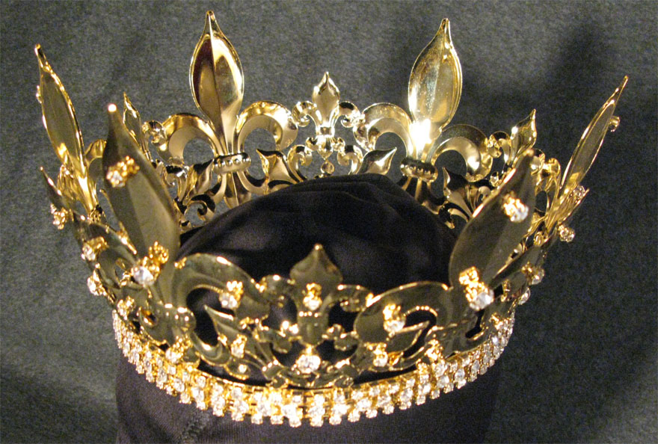
The Crown of Life
James 1:12

Slide 3
The Crown of Life
It Is A Blessed Condition To Receive It.
“Blessed is the man who endures temptation; for when he has been approved, he will receive the crown of life which the Lord has promised to those who love Him.” (James 1:12)

Slide 4
The Crown of Life
It Is A Blessed Condition To Receive It.
“And everyone who competes for the prize is temperate in all things. Now they do it to obtain a perishable crown, but we for an imperishable crown.” (1 Corinthians 9:25)

Slide 5
The Crown of Life
It Is A Blessed Condition To Receive It.
“For what is our hope, or joy, or crown of rejoicing? Is it not even you in the presence of our Lord Jesus Christ at His coming?” (1 Thessalonians 2:19)

Slide 6
The Crown of Life
It Is A Blessed Condition To Receive It.
It Is A Promise From The Lord.

Slide 7
The Crown of Life
It Is A Promise From The Lord.
“Blessed is the man who endures temptation; for when he has been approved, he will receive the crown of life which the Lord has promised to those who love Him.” (James 1:12)

Slide 8
The Crown of Life
It Is A Promise From The Lord.
“I press toward the goal for the prize of the upward call of God in Christ Jesus.” (Philippians 3:14)

Slide 9
The Crown of Life
It Is A Promise From The Lord.
“Paul, an apostle of Jesus Christ by the will of God, according to the promise of life which is in Christ Jesus …” (2 Timothy 1:1)

Slide 10
The Crown of Life
It Is A Promise From The Lord.
“And this is the promise that He has promised us—eternal life.” (1 John 2:25)

Slide 11
The Crown of Life
It Is A Blessed Condition To Receive It.
It Is A Promise From The Lord.
You Must Endure Temptation To Receive It.

Slide 12
The Crown of Life
You Must Endure Temptation To Receive It.
“Blessed is the man who endures temptation; for when he has been approved, he will receive the crown of life which the Lord has promised to those who love Him.” (James 1:12)

Slide 13
The Crown of Life
You Must Endure Temptation To Receive It.
“Shepherd the flock of God which is among you, serving as overseers, not by compulsion but willingly, not for dishonest gain but eagerly; nor as being lords over those entrusted to you, but being examples to the flock; and when the Chief Shepherd appears, you will receive the crown of glory that does not fade away.” (1 Peter 5:2-4)

Slide 14
The Crown of Life
You Must Endure Temptation To Receive It.
“Behold, I am coming quickly! Hold fast what you have, that no one may take your crown.” (Revelation 3:11)

Slide 15
The Crown of Life
You Must Endure Temptation To Receive It.
“Watch and pray, lest you enter into temptation. The spirit indeed is willing, but the flesh is weak.” (Mark 14:38)

Slide 16
The Crown of Life
You Must Endure Temptation To Receive It.
“But the ones on the rock are those who, when they hear, receive the word with joy; and these have no root, who believe for a while and in time of temptation fall away.” (Luke 8:13)

Slide 17
The Crown of Life
It Is A Blessed Condition To Receive It.
It Is A Promise From The Lord.
You Must Endure Temptation To Receive It.
You Must Be Approved.

Slide 18
The Crown of Life
You Must Be Approved.
“Blessed is the man who endures temptation; for when he has been approved, he will receive the crown of life which the Lord has promised to those who love Him.” (James 1:12)

Slide 19
The Crown of Life
You Must Be Approved.
“Do not fear any of those things which you are about to suffer. Indeed, the devil is about to throw some of you into prison, that you may be tested, and you will have tribulation ten days. Be faithful until death, and I will give you the crown of life. (Revelation 2:10)

Slide 20
The Crown of Life
You Must Be Approved.
“Be diligent to present yourself approved to God, a worker who does not need to be ashamed, rightly dividing the word of truth.” (2 Timothy 2:15)

Slide 21
The Crown of Life
It Is A Blessed Condition To Receive It.
It Is A Promise From The Lord.
You Must Endure Temptation To Receive It.
You Must Be Approved.
It Is For Those Who Love The Lord.

Slide 22
The Crown of Life
It Is For Those Who Love The Lord.
“Blessed is the man who endures temptation; for when he has been approved, he will receive the crown of life which the Lord has promised to those who love Him.” (James 1:12)

Slide 23
The Crown of Life
It Is For Those Who Love The Lord.
“I have fought the good fight, I have finished the race, I have kept the faith. Finally, there is laid up for me the crown of righteousness, which the Lord, the righteous Judge, will give to me on that Day, and not to me only but also to all who have loved His appearing.” (2 Timothy 4:7-8)

Slide 24
The Crown of Life
It Is For Those Who Love The Lord.
“If you love Me, keep My commandments.” (John 14:15)
“Greater love has no one than this, than to lay down one's life for his friends. You are My friends if you do whatever I command you.” (John 15:13-14)

Slide 25
The Crown of Life
It Is A Blessed Condition To Receive It.
It Is A Promise From The Lord.
You Must Endure Temptation To Receive It.
You Must Be Approved.
It Is For Those Who Love The Lord.

Slide 26
The Crown of Life

