Slide 1
Scripture Reading – Luke 12:16-21
“Then He spoke a parable to them, saying: ‘The ground of a certain rich man yielded plentifully. And he thought within himself, saying, 'What shall I do, since I have no room to store my crops?' So he said, 'I will do this: I will pull down my barns and build greater, and there I will store all my crops and my goods. And I will say to my soul, ‘Soul, you have many goods laid up for many years; take your ease; eat, drink, and be merry.’ But God said to him, 'Fool! This night your soul will be required of you; then whose will those things be which you have provided?' So is he who lays up treasure for himself, and is not rich toward God.’”

Slide 2
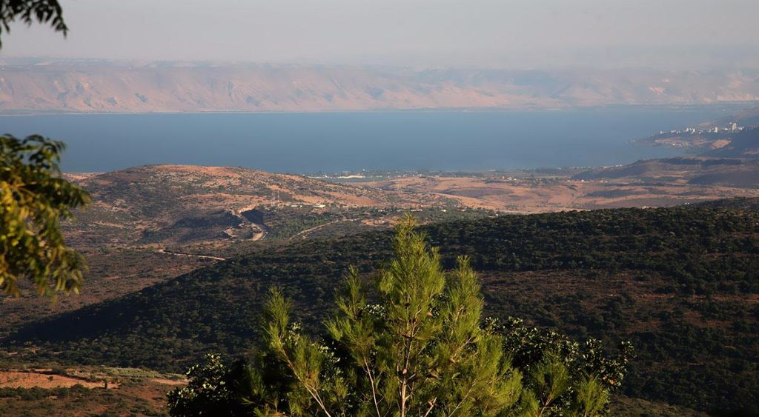
The Sermon on the Mount
“For I say to you, that unless your righteousness exceeds the righteousness of the scribes and Pharisees, you will by no means enter the kingdom of heaven." (Matthew 5:20)
Materialism will make us hypocrites.
Let’s Go Treasure Hunting!
Matthew 6:19-34

Slide 3
Let’s Go Treasure Hunting!
Identify YOUR Treasure. (Matthew 6:19-21)
“Do not lay up for yourselves treasures on earth, where moth and rust destroy and where thieves break in and steal; but lay up for yourselves treasures in heaven, where neither moth nor rust destroys and where thieves do not break in and steal. For where your treasure is, there your heart will be also.” (Matthew 6:19-21)

Slide 4
Let’s Go Treasure Hunting!
Identify YOUR Treasure. (Matthew 6:19-21)
“Now the Pharisees, who were lovers of money, also heard all these things, and they derided Him.” (Luke 16:14)
“Command those who are rich in this present age not to be haughty, nor to trust in uncertain riches but in the living God, who gives us richly all things to enjoy. Let them do good, that they be rich in good works, ready to give, willing to share, storing up for themselves a good foundation for the time to come, that they may lay hold on eternal life.” (1 Timothy 6:17-19)

Slide 5
Let’s Go Treasure Hunting!
Identify YOUR Treasure. (Matthew 6:19-21)
Search for the Treasure. (Matthew 6:22-23)

Slide 6
Let’s Go Treasure Hunting!
Search for the Treasure. (Matthew 6:22-23)
“The lamp of the body is the eye. If therefore your eye is good, your whole body will be full of light. But if your eye is bad, your whole body will be full of darkness. If therefore the light that is in you is darkness, how great is that darkness!” (Matthew 6:22-23)

Slide 7
Let’s Go Treasure Hunting!
Search for the Treasure. (Matthew 6:22-23)
“But those who desire to be rich fall into temptation and a snare, and into many foolish and harmful lusts which drown men in destruction and perdition. For the love of money is a root of all kinds of evil, for which some have strayed from the faith in their greediness, and pierced themselves through with many sorrows. But you, O man of God, flee these things and pursue righteousness, godliness, faith, love, patience, gentleness.” (1 Timothy 6:9-11)

Slide 8
Let’s Go Treasure Hunting!
Identify YOUR Treasure. (Matthew 6:19-21)
Search for the Treasure. (Matthew 6:22-23)
Look in the Right Place. (Matthew 6:24)

Slide 9
Let’s Go Treasure Hunting!
Look in the Right Place. (Matthew 6:24)
“No one can serve two masters; for either he will hate the one and love the other, or else he will be loyal to the one and despise the other. You cannot serve God and mammon.” (Matthew 6:24)

Slide 10
Let’s Go Treasure Hunting!
Look in the Right Place. (Matthew 6:24)
“If any of you lacks wisdom, let him ask of God, who gives to all liberally and without reproach, and it will be given to him. But let him ask in faith, with no doubting, for he who doubts is like a wave of the sea driven and tossed by the wind. For let not that man suppose that he will receive anything from the Lord; he is a double-minded man, unstable in all his ways.” (James 1:5-8)

Slide 11
Let’s Go Treasure Hunting!
Identify YOUR Treasure. (Matthew 6:19-21)
Search for the Treasure. (Matthew 6:22-23)
Look in the Right Place. (Matthew 6:24)
Protect Your Treasure. (Matthew 6:25-32)

Slide 12
Let’s Go Treasure Hunting!
Protect Your Treasure. (Matthew 6:25-32)
“Therefore I say to you, do not worry about your life, what you will eat or what you will drink; nor about your body, what you will put on. Is not life more than food and the body more than clothing? Look at the birds of the air, for they neither sow nor reap nor gather into barns; yet your heavenly Father feeds them. Are you not of more value than they? Which of you by worrying can add one cubit to his stature?” (Matthew 6:25-27)

Slide 13
Let’s Go Treasure Hunting!
Protect Your Treasure. (Matthew 6:25-32)
“So why do you worry about clothing? Consider the lilies of the field, how they grow: they neither toil nor spin; and yet I say to you that even Solomon in all his glory was not arrayed like one of these. Now if God so clothes the grass of the field, which today is, and tomorrow is thrown into the oven, will He not much more clothe you, O you of little faith? Therefore do not worry, saying, 'What shall we eat?' or 'What shall we drink?' or 'What shall we wear?' For after all these things the Gentiles seek. For your heavenly Father knows that you need all these things.” (Matthew 6:28-32)

Slide 14
Let’s Go Treasure Hunting!
Protect Your Treasure. (Matthew 6:25-32)
“For I am persuaded that neither death nor life, nor angels nor principalities nor powers, nor things present nor things to come, nor height nor depth, nor any other created thing, shall be able to separate us from the love of God which is in Christ Jesus our Lord.” (Romans 8:38-39)
Be anxious for nothing, but in everything by prayer and supplication, with thanksgiving, let your requests be made known to God; and the peace of God, which surpasses all understanding, will guard your hearts and minds through Christ Jesus. (Philippians 4:6-7)

Slide 15
Let’s Go Treasure Hunting!
Identify YOUR Treasure. (Matthew 6:19-21)
Search for the Treasure. (Matthew 6:22-23)
Look in the Right Place. (Matthew 6:24)
Protect Your Treasure. (Matthew 6:25-32)
Get Priorities Right! (Matthew 6:33-34)

Slide 16
Let’s Go Treasure Hunting!
Get Priorities Right! (Matthew 6:33-34)
“But seek first the kingdom of God and His righteousness, and all these things shall be added to you. Therefore do not worry about tomorrow, for tomorrow will worry about its own things. Sufficient for the day is its own trouble.” (Matthew 6:33-34)

Slide 17
Let’s Go Treasure Hunting!
Get Priorities Right! (Matthew 6:33-34)
“So we are always confident, knowing that while we are at home in the body we are absent from the Lord. For we walk by faith, not by sight. We are confident, yes, well pleased rather to be absent from the body and to be present with the Lord. Therefore we make it our aim, whether present or absent, to be well pleasing to Him. For we must all appear before the judgment seat of Christ, that each one may receive the things done in the body, according to what he has done, whether good or bad.” (2 Corinthians 5:6-10)

Slide 18
Let’s Go Treasure Hunting!
Identify YOUR Treasure. (Matthew 6:19-21)
Search for the Treasure. (Matthew 6:22-23)
Look in the Right Place. (Matthew 6:24)
Protect Your Treasure. (Matthew 6:25-32)
Get Priorities Right! (Matthew 6:33-34)

Slide 19
The Sermon on the Mount
Life Changing Attitudes
Matthew 5:1-16
Four Keys to Finding Treasure
Faith – “O you of little faith?” (Matthew 6:30)
Focus – “You cannot serve God and mammon.” (Matthew 6:24)
Father – “For your heavenly Father knows …” (Matthew 6:32)
First – “But seek first the kingdom of God …” (Matthew 6:33)
Let’s Go Treasure Hunting!
Matthew 6:19-34

