Slide 1
Scripture Reading – 1 Corinthians 6:9-11
“Do you not know that the unrighteous will not inherit the kingdom of God? Do not be deceived. Neither fornicators, nor idolaters, nor adulterers, nor homosexuals, nor sodomites, nor thieves, nor covetous, nor drunkards, nor revilers, nor extortioners will inherit the kingdom of God. And such were some of you. But you were washed, but you were sanctified, but you were justified in the name of the Lord Jesus and by the Spirit of our God.”

Slide 2
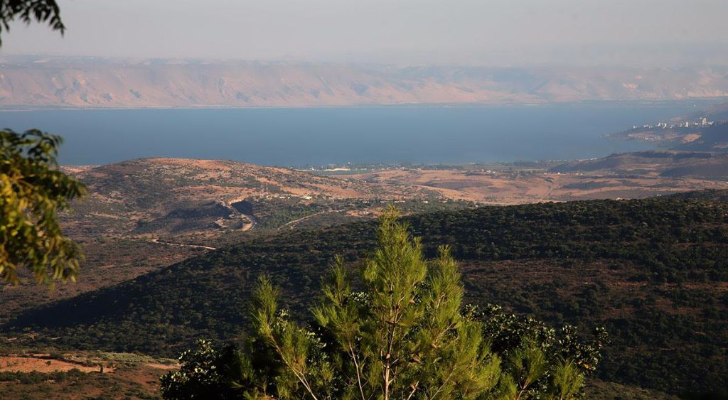
The Sermon on the Mount
Life Changing Attitudes
Matthew 5:1-16
“And seeing the multitudes, He went up on a mountain, and when He was seated His disciples came to Him.” (Matthew 5:1)
“For I say to you, that unless your righteousness exceeds the righteousness of the scribes and Pharisees, you will by no means enter the kingdom of heaven.” (Matthew 5:20)
Life Changing Attitudes
Matthew 5:1-16

Slide 3
Life Changing Attitudes
About Ourselves (Matthew 5:3)
“Blessed are the poor in spirit, For theirs is the kingdom of heaven.”
“For I say, through the grace given to me, to everyone who is among you, not to think of himself more highly than he ought to think, but to think soberly, as God has dealt to each one a measure of faith.” (Romans 12:3)
“Therefore humble yourselves under the mighty hand of God, that He may exalt you in due time …” (1 Peter 5:6)

Slide 4
Life Changing Attitudes
About Ourselves (Matthew 5:3)
“Thus says the LORD: "Heaven is My throne, And earth is My footstool. Where is the house that you will build Me? And where is the place of My rest? For all those things My hand has made, And all those things exist," Says the LORD. "But on this one will I look: On him who is poor and of a contrite spirit, And who trembles at My word.” (Isaiah 66:1-2)

Slide 5
Life Changing Attitudes
About Ourselves
About Sin

Slide 6
Life Changing Attitudes
About Sin (Matthew 5:4-6)
“Blessed are those who mourn, For they shall be comforted. Blessed are the meek, For they shall inherit the earth. Blessed are those who hunger and thirst for righteousness, For they shall be filled.”

Slide 7
Life Changing Attitudes
About Sin (Matthew 5:4-6)
“Also He spoke this parable to some who trusted in themselves that they were righteous, and despised others: Two men went up to the temple to pray, one a Pharisee and the other a tax collector. The Pharisee stood and prayed thus with himself, ‘God, I thank You that I am not like other men—extortioners, unjust, adulterers, or even as this tax collector. I fast twice a week; I give tithes of all that I possess.’ And the tax collector, standing afar off, would not so much as raise his eyes to heaven, but beat his breast, saying, ‘God, be merciful to me a sinner!’ I tell you, this man went down to his house justified rather than the other; for everyone who exalts himself will be humbled, and he who humbles himself will be exalted.” (Luke 18:9-14)

Slide 8
Life Changing Attitudes
About Sin (Matthew 5:4-6)
“Blessed are those who mourn, For they shall be comforted. Blessed are the meek, For they shall inherit the earth. Blessed are those who hunger and thirst for righteousness, For they shall be filled.”
“Now the man Moses was very humble, more than all men who were on the face of the earth.” (Numbers 12:3)
“Take My yoke upon you and learn from Me, for I am gentle and lowly in heart, and you will find rest for your souls.” (Matthew 11:29)

Slide 9
Life Changing Attitudes
About Ourselves
About Sin
About the Lord

Slide 10
Life Changing Attitudes
About the Lord (Matthew 5:7-9)
“Blessed are the merciful, For they shall obtain mercy. Blessed are the pure in heart, For they shall see God. Blessed are the peacemakers, For they shall be called sons of God.”
“But God, who is rich in mercy, because of His great love with which He loved us, even when we were dead in trespasses, made us alive together with Christ (by grace you have been saved), and raised us up together, and made us sit together in the heavenly places in Christ Jesus, that in the ages to come He might show the exceeding riches of His grace in His kindness toward us in Christ Jesus.” (Ephesians 2:4-7)

Slide 11
Life Changing Attitudes
About Ourselves
About Sin
About the Lord
About the World

Slide 12
Life Changing Attitudes
About the World (Matthew 5:10-16)
“Blessed are those who are persecuted for righteousness sake, For theirs is the kingdom of heaven. ‘Blessed are you when they revile and persecute you, and say all kinds of evil against you falsely for My sake. Rejoice and be exceedingly glad, for great is your reward in heaven, for so they persecuted the prophets who were before you. You are the salt of the earth; but if the salt loses its flavor, how shall it be seasoned? It is then good for nothing but to be thrown out and trampled underfoot by men. You are the light of the world. A city that is set on a hill cannot be hidden. Nor do they light a lamp and put it under a basket, but on a lampstand, and it gives light to all who are in the house. Let your light so shine before men, that they may see your good works and glorify your Father in heaven.” (Matthew 5:10-16)

Slide 13
Life Changing Attitudes
About the World (Matthew 5:10-16)
“Where do wars and fights come from among you? Do they not come from your desires for pleasure that war in your members? You lust and do not have. You murder and covet and cannot obtain. You fight and war. Yet you do not have because you do not ask. You ask and do not receive, because you ask amiss, that you may spend it on your pleasures. Adulterers and adulteresses! Do you not know that friendship with the world is enmity with God? Whoever therefore wants to be a friend of the world makes himself an enemy of God.” (James 4:1-4)

Slide 14
Life Changing Attitudes
About Ourselves
About Sin
About the Lord
About the World
Do You Want A Changed Life?

