Slide 1
Scripture Reading – Matthew 5:17-20
“Do not think that I came to destroy the Law or the Prophets. I did not come to destroy but to fulfill. For assuredly, I say to you, till heaven and earth pass away, one jot or one tittle will by no means pass from the law till all is fulfilled. Whoever therefore breaks one of the least of these commandments, and teaches men so, shall be called least in the kingdom of heaven; but whoever does and teaches them, he shall be called great in the kingdom of heaven. For I say to you, that unless your righteousness exceeds the righteousness of the scribes and Pharisees, you will by no means enter the kingdom of heaven.”

Slide 2
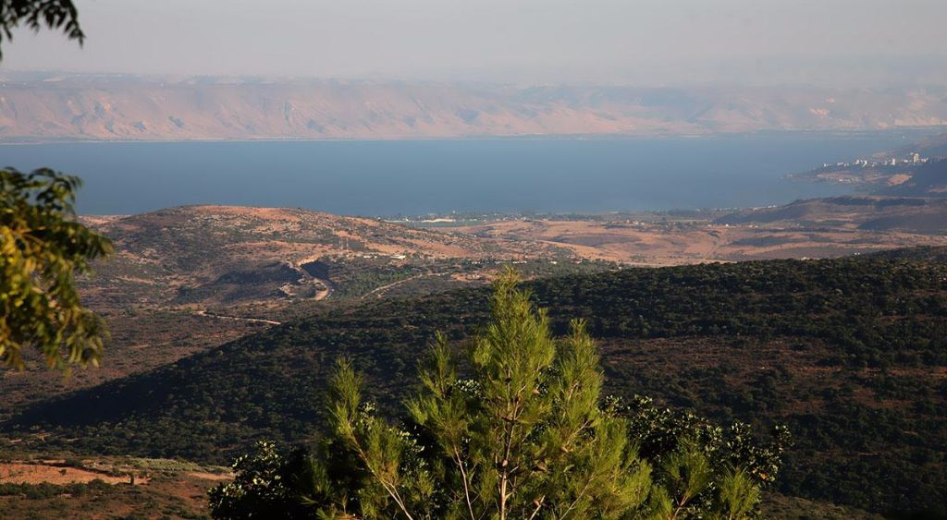
The Sermon on the Mount
Life Changing Attitudes
Matthew 5:1-16
“And seeing the multitudes, He went up on a mountain, and when He was seated His disciples came to Him.” (Matthew 5:1)
“For I say to you, that unless your righteousness exceeds the righteousness of the scribes and Pharisees, you will by no means enter the kingdom of heaven.” (Matthew 5:20)
Unrighteousness
Begins in the Heart
Matthew 5:21-48

Slide 3
The Sermon on the Mount
Life Changing Attitudes
Matthew 5:1-16
“Do not think that I came to destroy the Law or the Prophets. I did not come to destroy but to fulfill.” (Matthew 5:17)
“And so it was, when Jesus had ended these sayings, that the people were astonished at His teaching, for He taught them as one having authority, and not as the scribes.” (Matthew 7:28-29)
Unrighteousness
Begins in the Heart
Matthew 5:21-48

Slide 4
Unrighteousness Begins in the Heart
Anger
“You have heard that it was said to those of old, 'YOU SHALL NOT MURDER, and whoever murders will be in danger of the judgment.' But I say to you that whoever is angry with his brother without a cause shall be in danger of the judgment. And whoever says to his brother, 'Raca!' shall be in danger of the council. But whoever says, 'You fool!' shall be in danger of hell fire. Therefore if you bring your gift to the altar, and there remember that your brother has something against you, leave your gift there before the altar, and go your way. First be reconciled to your brother, and then come and offer your gift. Agree with your adversary quickly, while you are on the way with him, lest your adversary deliver you to the judge, the judge hand you over to the officer, and you be thrown into prison. Assuredly, I say to you, you will by no means get out of there till you have paid the last penny.” (Matthew 5:21-26)

Slide 5
Unrighteousness Begins in the Heart
Anger

Slide 6
Unrighteousness Begins in the Heart
Anger
Lust

Slide 7
Unrighteousness Begins in the Heart
Lust
“You have heard that it was said to those of old, 'YOU SHALL NOT COMMIT ADULTERY.' But I say to you that whoever looks at a woman to lust for her has already committed adultery with her in his heart. If your right eye causes you to sin, pluck it out and cast it from you; for it is more profitable for you that one of your members perish, than for your whole body to be cast into hell. And if your right hand causes you to sin, cut it off and cast it from you; for it is more profitable for you that one of your members perish, than for your whole body to be cast into hell. "Furthermore it has been said, 'Whoever divorces his wife, let him give her a certificate of divorce.' But I say to you that whoever divorces his wife for any reason except sexual immorality causes her to commit adultery; and whoever marries a woman who is divorced commits adultery.” (Matthew 5:27-32)

Slide 8
Unrighteousness Begins in the Heart
Lust

Slide 9
Unrighteousness Begins in the Heart
Anger
Lust
Dishonesty

Slide 10
Unrighteousness Begins in the Heart
Dishonesty
“Again you have heard that it was said to those of old, 'You shall not swear falsely, but shall perform your oaths to the Lord.' But I say to you, do not swear at all: neither by heaven, for it is God's throne; nor by the earth, for it is His footstool; nor by Jerusalem, for it is the city of the great King. Nor shall you swear by your head, because you cannot make one hair white or black. But let your 'Yes' be 'Yes,' and your 'No,' 'No.' For whatever is more than these is from the evil one.” (Matthew 5:33-37)

Slide 11
Unrighteousness Begins in the Heart
Dishonesty

Slide 12
Unrighteousness Begins in the Heart
Anger
Lust
Dishonesty
Retaliation

Slide 13
Unrighteousness Begins in the Heart
Retaliation
“You have heard that it was said, 'AN EYE FOR AN EYE AND A TOOTH FOR A TOOTH.' But I tell you not to resist an evil person. But whoever slaps you on your right cheek, turn the other to him also. If anyone wants to sue you and take away your tunic, let him have your cloak also. And whoever compels you to go one mile, go with him two. Give to him who asks you, and from him who wants to borrow from you do not turn away.” (Matthew 5:38-42)

Slide 14
Unrighteousness Begins in the Heart
Retaliation

Slide 15
Unrighteousness Begins in the Heart
Anger
Lust
Dishonesty
Retaliation
Hate

Slide 16
Unrighteousness Begins in the Heart
Hate
“You have heard that it was said, 'YOU SHALL LOVE YOUR NEIGHBOR and hate your enemy.' But I say to you, love your enemies, bless those who curse you, do good to those who hate you, and pray for those who spitefully use you and persecute you, that you may be sons of your Father in heaven; for He makes His sun rise on the evil and on the good, and sends rain on the just and on the unjust. For if you love those who love you, what reward have you? Do not even the tax collectors do the same? And if you greet your brethren only, what do you do more than others? Do not even the tax collectors do so? Therefore you shall be perfect, just as your Father in heaven is perfect.” (Matthew 5:43-48)

Slide 17
Unrighteousness Begins in the Heart
Hate

Slide 18
Unrighteousness Begins in the Heart
Anger
Lust
Dishonesty
Retaliation
Hate

Slide 19
The Sermon on the Mount
Life Changing Attitudes
Matthew 5:1-16
God wants you to be saved!
“For this is good and acceptable in the sight of God our Savior, who desires all men to be saved and to come to the knowledge of the truth.” (1 Timothy 2:3-4)
Unrighteousness
Begins in the Heart
Matthew 5:21-48

