Slide 1
Scripture Reading – Matthew 27:15-23
“Now at the feast the governor was accustomed to releasing to the multitude one prisoner whom they wished. And at that time they had a notorious prisoner called Barabbas. Therefore, when they had gathered together, Pilate said to them, ‘Whom do you want me to release to you? Barabbas, or Jesus who is called Christ?’ For he knew that they had handed Him over because of envy. While he was sitting on the judgment seat, his wife sent to him, saying, ‘Have nothing to do with that just Man, for I have suffered many things today in a dream because of Him.’ But the chief priests and elders persuaded the multitudes that they should ask for Barabbas and destroy Jesus. The governor answered and said to them, ‘Which of the two do you want me to release to you?’ They said, ‘Barabbas!’ Pilate said to them, ‘What then shall I do with Jesus who is called Christ?’ They all said to him, ‘Let Him be crucified!’ Then the governor said, ‘Why, what evil has He done?’ But they cried out all the more, saying, ‘Let Him be crucified!’”

Slide 2
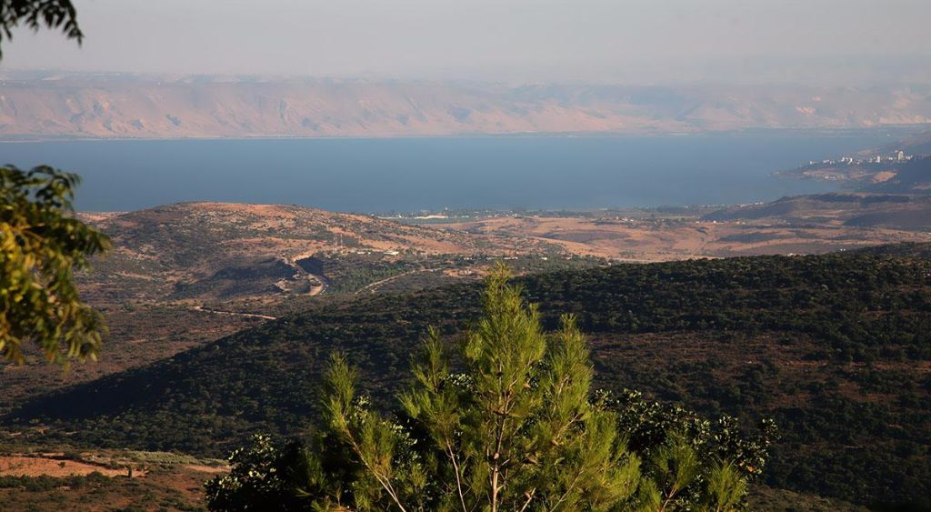
The Sermon on the Mount
Life Changing Attitudes Matthew 5:1-16
To Destroy of Fulfill? Matthew 5:17-20
Unrighteousness Begins in the Heart Matthew 5:21-48
Ruining Good by Wanting to be Seen Matthew 6:1-18
Let’s Go Treasure Hunting Matthew 6:19-34
Being Ready to Help Others Matthew 7:1-12
The Difficult Way To Life Matthew 7:13-27

Slide 3
The Sermon on the Mount
The Response to Jesus
Matthew 7:28 – 8:1

Slide 4
The Response To Jesus
People Were Astonished
“And so it was, when Jesus had ended these sayings, that the people were astonished at His teaching …” (Matthew 7:28)
“And when the multitudes heard this, they were astonished at His teaching.” (Matthew 22:33)

Slide 5
The Response To Jesus
People Were Astonished
“Then they were all amazed, so that they questioned among themselves, saying, ‘What is this? What new doctrine is this? For with authority He commands even the unclean spirits, and they obey Him.’” (Mark 1:27)
“And the scribes and chief priests heard it and sought how they might destroy Him; for they feared Him, because all the people were astonished at His teaching.” (Mark 11:18)

Slide 6
The Response To Jesus
People Were Astonished
“Then the proconsul believed, when he saw what had been done, being astonished at the teaching of the Lord.” (Acts 13:12)

Slide 7
The Response To Jesus
People Were Astonished
They Saw The Authority Of Jesus’ Teaching
“… for He taught them as one having authority, and not as the scribes.” (Matthew 7:29)
Luke 20:1-8
“However, when He, the Spirit of truth, has come, He will guide you into all truth; for He will not speak on His own authority, but whatever He hears He will speak; and He will tell you things to come.” (John 16:13)

Slide 8
The Response To Jesus
People Were Astonished
They Saw The Authority Of Jesus’ Teaching
“Therefore I write these things being absent, lest being present I should use sharpness, according to the authority which the Lord has given me for edification and not for destruction.” (2 Corinthians 13:10)
“Speak these things, exhort, and rebuke with all authority. Let no one despise you.” (Titus 2:15)

Slide 9
The Response To Jesus
People Were Astonished
They Saw The Authority Of Jesus’ Teaching
“And Jesus came and spoke to them, saying, ‘All authority has been given to Me in heaven and on earth. Go therefore and make disciples of all the nations, baptizing them in the name of the Father and of the Son and of the Holy Spirit, teaching them to observe all things that I have commanded you; and lo, I am with you always, even to the end of the age.’ Amen.” (Matthew 28:18-20)

Slide 10
The Response To Jesus
People Were Astonished
They Saw The Authority Of Jesus’ Teaching
Multitudes Followed Jesus
“When He had come down from the mountain, great multitudes followed Him.” (Matthew 8:1)
“When Jesus heard it, He departed from there by boat to a deserted place by Himself. But when the multitudes heard it, they followed Him on foot from the cities. And when Jesus went out He saw a great multitude; and He was moved with compassion for them, and healed their sick” (Matthew 14:13-14)

Slide 11
The Response To Jesus
People Were Astonished
They Saw The Authority Of Jesus’ Teaching
Multitudes Followed Jesus
“From that time many of His disciples went back and walked with Him no more. Then Jesus said to the twelve, ‘Do you also want to go away?’ But Simon Peter answered Him, ‘Lord, to whom shall we go? You have the words of eternal life. Also we have come to believe and know that You are the Christ, the Son of the living God.’” (John 6:66-69)

Slide 12
The Response To Jesus
People Were Astonished
They Saw The Authority Of Jesus’ Teaching
Multitudes Followed Jesus
“Now it happened as they journeyed on the road, that someone said to Him, ‘Lord, I will follow You wherever You go.’ And Jesus said to him, ‘Foxes have holes and birds of the air have nests, but the Son of Man has nowhere to lay His head.’ Then He said to another, ‘Follow Me.’ But he said, ‘Lord, let me first go and bury my father.’ Jesus said to him, ‘Let the dead bury their own dead, but you go and preach the kingdom of God.’ And another also said, ‘Lord, I will follow You, but let me first go and bid them farewell who are at my house.’ But Jesus said to him, ‘No one, having put his hand to the plow, and looking back, is fit for the kingdom of God.’” (Luke 9:57-62)

Slide 13
The Response To Jesus
People Were Astonished
They Saw The Authority Of Jesus’ Teaching
Multitudes Followed Jesus
“Then He said to them all, ‘If anyone desires to come after Me, let him deny himself, and take up his cross daily, and follow Me. For whoever desires to save his life will lose it, but whoever loses his life for My sake will save it. For what profit is it to a man if he gains the whole world, and is himself destroyed or lost?’” (Luke 9:23-25)

Slide 14
The Response To Jesus
People Were Astonished
They Saw The Authority Of Jesus’ Teaching
Multitudes Followed Jesus

