Slide 1
Scripture Reading – Matthew 7:13-14
“Enter by the narrow gate; for wide is the gate and broad is the way that leads to destruction, and there are many who go in by it. Because narrow is the gate and difficult is the way which leads to life, and there are few who find it.”

Slide 2
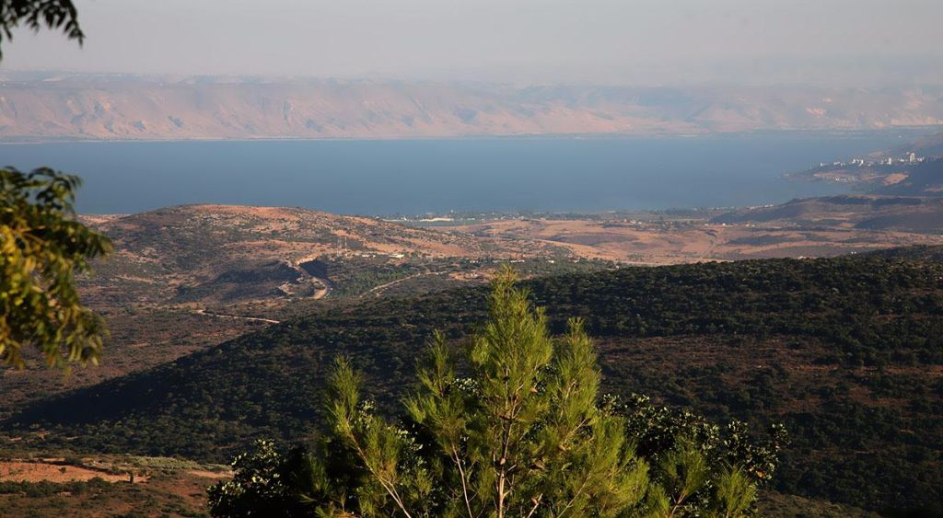
The Sermon on the Mount
Life Changing Attitudes Matthew 5:1-16
To Destroy of Fulfill? Matthew 5:17-20
Unrighteousness Begins in the Heart Matthew 5:21-48
Ruining Good by Wanting to be Seen Matthew 6:1-18
Let’s Go Treasure Hunting! Matthew 6:19-34
Being Ready to Help Others Matthew 7:1-12
The Difficult Way To Life Matthew 7:13-27

Slide 3
The Sermon on the Mount
“For I say to you, that unless your righteousness exceeds the righteousness of the scribes and Pharisees, you will by no means enter the kingdom of heaven.” (Matthew 5:20)
The Difficult Way To Life
Matthew 5:13-27

Slide 4
The Difficult Way To Life
“Enter by the narrow gate; for wide is the gate and broad is the way that leads to destruction, and there are many who go in by it. Because narrow is the gate and difficult is the way which leads to life, and there are few who find it.” (Matthew 7:13-14)

Slide 5
The Difficult Way To Life
There Are Wolves!
“Beware of false prophets, who come to you in sheep's clothing, but inwardly they are ravenous wolves. You will know them by their fruits. Do men gather grapes from thornbushes or figs from thistles? Even so, every good tree bears good fruit, but a bad tree bears bad fruit. A good tree cannot bear bad fruit, nor can a bad tree bear good fruit. Every tree that does not bear good fruit is cut down and thrown into the fire. Therefore by their fruits you will know them.” (Matthew 7:15-20)

Slide 6
The Difficult Way To Life
There Are Wolves!
“Go your way; behold, I send you out as lambs among wolves.” (Luke 10:3)
“For I know this, that after my departure savage wolves will come in among you, not sparing the flock. Also from among yourselves men will rise up, speaking perverse things, to draw away the disciples after themselves.” (Acts 20:29-30)

Slide 7
The Difficult Way To Life
There Are Wolves!
“Now the works of the flesh are evident, which are: adultery, fornication, uncleanness, lewdness, idolatry, sorcery, hatred, contentions, jealousies, outbursts of wrath, selfish ambitions, dissensions, heresies, envy, murders, drunkenness, revelries, and the like; of which I tell you beforehand, just as I also told you in time past, that those who practice such things will not inherit the kingdom of God.” (Galatians 5:19-21)
“But the fruit of the Spirit is love, joy, peace, longsuffering, kindness, goodness, faithfulness, gentleness, self-control. Against such there is no law.” (Galatians 5:22-23)

Slide 8
The Difficult Way To Life
There Are Wolves!
Saying But Not Doing!
“Not everyone who says to Me, ‘Lord, Lord,’ shall enter the kingdom of heaven, but he who does the will of My Father in heaven. Many will say to Me in that day, ‘Lord, Lord, have we not prophesied in Your name, cast out demons in Your name, and done many wonders in Your name?’ And then I will declare to them, ‘I never knew you; depart from Me, you who practice lawlessness!’” (Matthew 7:21-23)

Slide 9
The Difficult Way To Life
There Are Wolves!
Saying But Not Doing!
“Therefore whatever they tell you to observe, that observe and do, but do not do according to their works; for they say, and do not do.” (Matthew 23:3)
“They profess to know God, but in works they deny Him, being abominable, disobedient, and disqualified for every good work.” (Titus 1:16)

Slide 10
The Difficult Way To Life
There Are Wolves!
Saying But Not Doing!
Hearing But Not Doing!
“Therefore whoever hears these sayings of Mine, and does them, I will liken him to a wise man who built his house on the rock: and the rain descended, the floods came, and the winds blew and beat on that house; and it did not fall, for it was founded on the rock. ‘But everyone who hears these sayings of Mine, and does not do them, will be like a foolish man who built his house on the sand: and the rain descended, the floods came, and the winds blew and beat on that house; and it fell. And great was its fall.’” (Matthew 7:24-27)

Slide 11
The Difficult Way To Life
There Are Wolves!
Saying But Not Doing!
Hearing But Not Doing!
“What does it profit, my brethren, if someone says he has faith but does not have works? Can faith save him? If a brother or sister is naked and destitute of daily food, and one of you says to them, ‘Depart in peace, be warmed and filled,’ but you do not give them the things which are needed for the body, what does it profit? Thus also faith by itself, if it does not have works, is dead.” (James 2:14-17)

Slide 12
The Difficult Way To Life
There Are Wolves!
Saying But Not Doing!
Hearing But Not Doing!
“But do you want to know, O foolish man, that faith without works is dead? Was not Abraham our father justified by works when he offered Isaac his son on the altar? Do you see that faith was working together with his works, and by works faith was made perfect? And the Scripture was fulfilled which says, ‘ABRAHAM BELIEVED GOD, AND IT WAS ACCOUNTED TO HIM FOR RIGHTEOUSNESS.’ And he was called the friend of God. You see then that a man is justified by works, and not by faith only.” (James 2:20-24)

Slide 13
The Difficult Way To Life
There Are Wolves!
Saying But Not Doing!
Hearing But Not Doing!

