Slide 1
Seekers “The LORD looks down from heaven upon the children of men, To see if there are any who understand, who seek God.” (Psalms 14:2)

Slide 2
Seekers
Bread Seekers
“Jesus answered them and said, ‘Most assuredly, I say to you, you seek Me, not because you saw the signs, but because you ate of the loaves and were filled. Do not labor for the food which perishes, but for the food which endures to everlasting life, which the Son of Man will give you, because God the Father has set His seal on Him.’” (John 6:26-27)
“Blessed are those who hunger and thirst for righteousness, For they shall be filled.”(Matthew 5:6)

Slide 3
Seekers
Bread Seekers
Glory Seekers

Slide 4
Seekers
Glory Seekers
“Nevertheless even among the rulers many believed in Him, but because of the Pharisees they did not confess Him, lest they should be put out of the synagogue; for they loved the praise of men more than the praise of God.” (John 12:42-43)
“And I do not seek My own glory; there is One who seeks and judges.” (John 8:50)
“And He is the head of the body, the church, who is the beginning, the firstborn from the dead, that in all things He may have the preeminence.” (Colossians 1:18)

Slide 5
Seekers
Bread Seekers
Glory Seekers
Fault Seekers

Slide 6
Seekers
Fault Seekers
“Do all things without complaining and disputing, that you may become blameless and harmless, children of God without fault in the midst of a crooked and perverse generation, among whom you shine as lights in the world, holding fast the word of life, so that I may rejoice in the day of Christ that I have not run in vain or labored in vain.” (Philippians 2:14-16)
“These are grumblers, complainers, walking according to their own lusts; and they mouth great swelling words, flattering people to gain advantage.” (Jude 16)

Slide 7
Seekers
Bread Seekers
Glory Seekers
Fault Seekers
Truth Seekers

Slide 8
Seekers
Truth Seekers
“These were more fair-minded than those in Thessalonica, in that they received the word with all readiness, and searched the Scriptures daily to find out whether these things were so.” (Acts 17:11)
“Then Jesus said to those Jews who believed Him, ‘If you abide in My word, you are My disciples indeed. And you shall know the truth, and the truth shall make you free.’” (John 8:31-32)

Slide 9
Seekers
Bread Seekers
Glory Seekers
Fault Seekers
Truth Seekers
Peace Seekers

Slide 10
Seekers
Peace Seekers
“If it is possible, as much as depends on you, live peaceably with all men.” (Romans 12:18)
“Finally, all of you be of one mind, having compassion for one another; love as brothers, be tenderhearted, be courteous; not returning evil for evil or reviling for reviling, but on the contrary blessing, knowing that you were called to this, that you may inherit a blessing.” (1 Peter 3:8-9)

Slide 11
Seekers
Bread Seekers
Glory Seekers
Fault Seekers
Truth Seekers
Peace Seekers
Kingdom Seekers

Slide 12
Seekers
Kingdom Seekers
“But seek first the kingdom of God and His righteousness, and all these things shall be added to you.” (Matthew 6:33)
“The wicked in his proud countenance does not seek God; God is in none of his thoughts.” (Psalms 10:4)
“One thing I have desired of the LORD, That will I seek: That I may dwell in the house of the LORD All the days of my life, To behold the beauty of the LORD, And to inquire in His temple.” (Psalms 27:4)

Slide 13
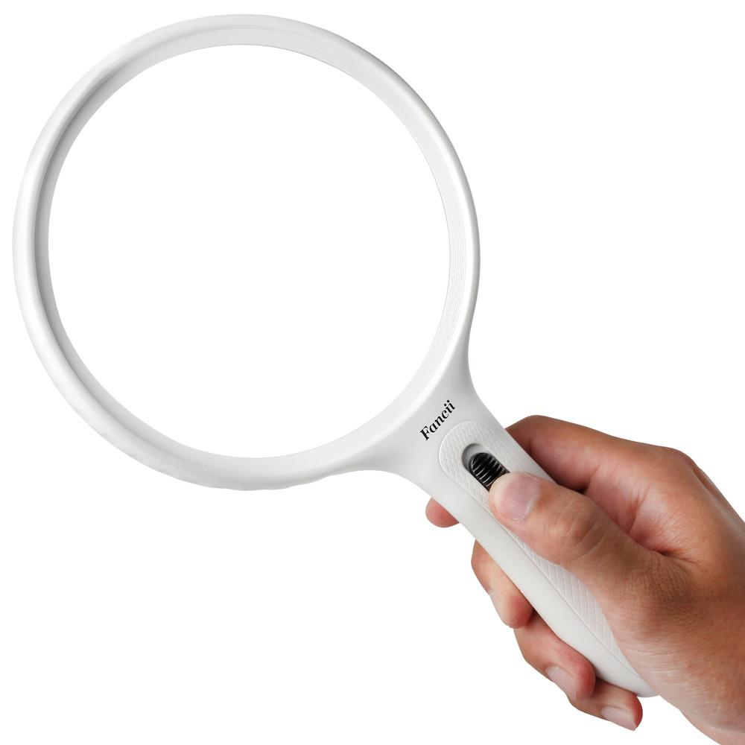
Seekers
Bread Seekers
Glory Seekers
Fault Seekers
Truth Seekers
Peace Seekers
Kingdom Seekers
What Are You Seeking?

