Slide 1
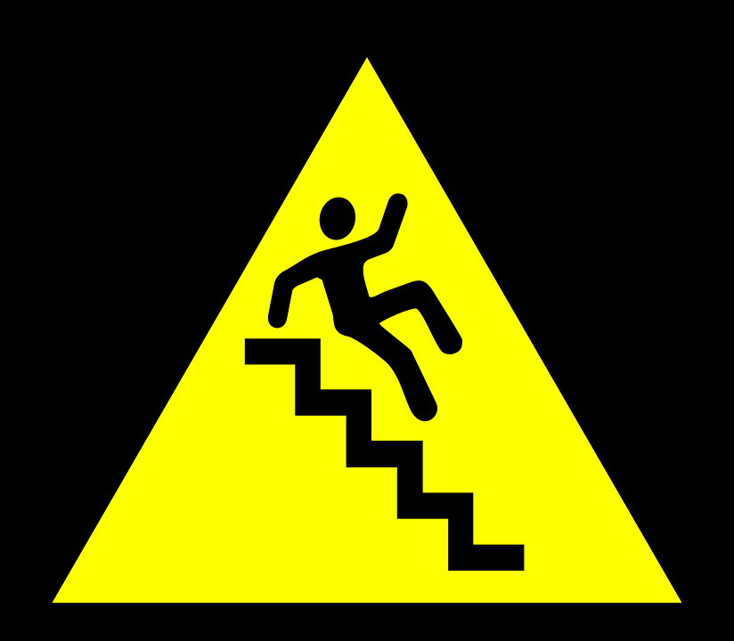
If They Fall
Hebrews 6:4-12

Slide 2
If They Fall Away
Who are we talking about?
“For it is impossible for those who were once enlightened, and have tasted the heavenly gift, and have become partakers of the Holy Spirit, and have tasted the good word of God and the powers of the age to come …” (Hebrews 6:4-5)
What happens?

Slide 3
If They Fall Away
What Happens?
Jesus is crucified … again!
Jesus is put to an open shame!
“… if they fall away, to renew them again to repentance, since they crucify again for themselves the Son of God, and put Him to an open shame.” (Hebrews 6:6)

Slide 4
If They Fall Away
What Happens?
Jesus is crucified … again!
Jesus is put to an open shame!
They are rejected!
“For the earth which drinks in the rain that often comes upon it, and bears herbs useful for those by whom it is cultivated, receives blessing from God; but if it bears thorns and briers, it is rejected and near to being cursed, whose end is to be burned.” (Hebrews 6:7-8)

Slide 5
If They Fall Away
How Can This Be Avoided?
Hear The Warning!
“But, beloved, we are confident of better things concerning you, yes, things that accompany salvation, though we speak in this manner.” (Hebrews 6:9)

Slide 6
If They Fall Away
How Can This Be Avoided?
Hear The Warning!
Remember God Remembers!
Keep Working!
“For God is not unjust to forget your work and labor of love which you have shown toward His name, in that you have ministered to the saints, and do minister.” (Hebrews 6:10)

Slide 7
If They Fall Away
How Can This Be Avoided?
Hear The Warning!
Remember God Remembers!
Keep Working!
Hold On To Hope To The End!
“And we desire that each one of you show the same diligence to the full assurance of hope until the end …” (Hebrews 6:11)

Slide 8
If They Fall Away
How Can This Be Avoided?
Hear The Warning!
Remember God Remembers!
Keep Working!
Hold On To Hope To The End!
Keep Your Intensity!
Find Good Examples!
“… that you do not become sluggish, but imitate those who through faith and patience inherit the promises.” (Hebrews 6:12)

Slide 9
If They Fall Away
What Happens?
How Can This Be Avoided?
What If I Fall Away?
“If we say that we have no sin, we deceive ourselves, and the truth is not in us. If we confess our sins, He is faithful and just to forgive us our sins and to cleanse us from all unrighteousness. If we say that we have not sinned, we make Him a liar, and His word is not in us.” (1 John 1:8-10)

