Slide 1
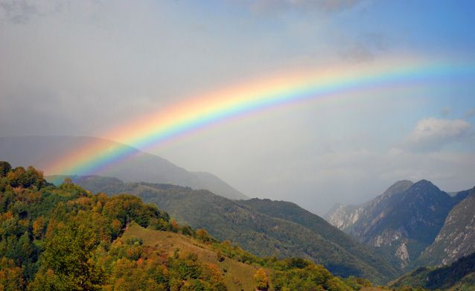
Reclaiming the Rainbow
“I set My rainbow in the cloud …”
(Genesis 9:13)

Slide 2
Reclaiming the Rainbow
Never Be A Flood Again To Destroy The Earth
“Thus I establish My covenant with you: Never again shall all flesh be cut off by the waters of the flood; never again shall there be a flood to destroy the earth." And God said: ‘This is the sign of the covenant which I make between Me and you, and every living creature that is with you, for perpetual generations: I set My rainbow in the cloud, and it shall be for the sign of the covenant between Me and the earth.’” (Genesis 9:11-13)

Slide 3
Reclaiming the Rainbow
Never Be A Flood Again To Destroy The Earth
God Is Gracious

Slide 4
Reclaiming the Rainbow
God Is Gracious
“Then the LORD saw that the wickedness of man was great in the earth, and that every intent of the thoughts of his heart was only evil continually. And the LORD was sorry that He had made man on the earth, and He was grieved in His heart. So the LORD said, ‘I will destroy man whom I have created from the face of the earth, both man and beast, creeping thing and birds of the air, for I am sorry that I have made them.’” (Genesis 6:5-7)
“But Noah found grace in the eyes of the LORD.” (Genesis 6:8)
“And God said to Noah, ‘This is the sign of the covenant which I have established between Me and all flesh that is on the earth.’” (Genesis 9:17)

Slide 5
Reclaiming the Rainbow
Never Be A Flood Again To Destroy The Earth
God Is Gracious
God Is In Control

Slide 6
Reclaiming the Rainbow
God Is In Control
“In the beginning God created the heavens and the earth.” (Genesis 1:1)
“In the six hundredth year of Noah's life, in the second month, the seventeenth day of the month, on that day all the fountains of the great deep were broken up, and the windows of heaven were opened. And the rain was on the earth forty days and forty nights.” (Genesis 7:11-12)
“So He destroyed all living things which were on the face of the ground: both man and cattle, creeping thing and bird of the air. They were destroyed from the earth. Only Noah and those who were with him in the ark remained alive.” (Genesis 7:23)

Slide 7
Reclaiming the Rainbow
God Is In Control
“Then God remembered Noah, and every living thing, and all the animals that were with him in the ark. And God made a wind to pass over the earth, and the waters subsided. The fountains of the deep and the windows of heaven were also stopped, and the rain from heaven was restrained.” (Genesis 8:1-2)
“I set My rainbow in the cloud, and it shall be for the sign of the covenant between Me and the earth. It shall be, when I bring a cloud over the earth, that the rainbow shall be seen in the cloud; and I will remember My covenant which is between Me and you and every living creature of all flesh; the waters shall never again become a flood to destroy all flesh.” (Genesis 9:13-15)

Slide 8
Reclaiming the Rainbow
Never Be A Flood Again To Destroy The Earth
God Is Gracious
God Is In Control
God Remembers For A Long Time

Slide 9
Reclaiming the Rainbow
God Remembers For A Long Time
“‘The rainbow shall be in the cloud, and I will look on it to remember the everlasting covenant between God and every living creature of all flesh that is on the earth.’ And God said to Noah, ‘This is the sign of the covenant which I have established between Me and all flesh that is on the earth.’” (Genesis 9:16-17)

Slide 10
Reclaiming the Rainbow
Never Be A Flood Again To Destroy The Earth
God Is Gracious
God Is In Control
God Remembers For A Long Time
God Keeps His Promises

Slide 11
Reclaiming the Rainbow
God Keeps His Promises
“The LORD sat enthroned at the Flood, And the LORD sits as King forever.” (Psalms 29:10)
“For if God did not spare the angels who sinned, but cast them down to hell and delivered them into chains of darkness, to be reserved for judgment; and did not spare the ancient world, but saved Noah, one of eight people, a preacher of righteousness, bringing in the flood on the world of the ungodly …” (2 Peter 2:4-5)

Slide 12
Reclaiming the Rainbow
God Keeps His Promises
“Grace and peace be multiplied to you in the knowledge of God and of Jesus our Lord, as His divine power has given to us all things that pertain to life and godliness, through the knowledge of Him who called us by glory and virtue, by which have been given to us exceedingly great and precious promises, that through these you may be partakers of the divine nature, having escaped the corruption that is in the world through lust.” (2 Peter 1:2-4)

Slide 13
Reclaiming the Rainbow
Never Be A Flood Again To Destroy The Earth
God Is Gracious
God Is In Control
God Remembers For A Long Time
God Keeps His Promises

