Slide 1
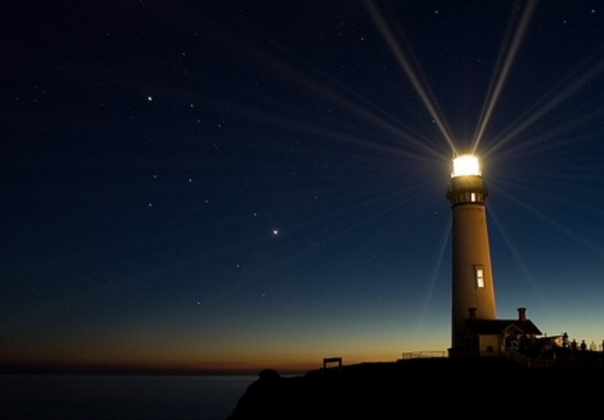
Light in the Dark
“And God saw the light, that it was good; and God divided the light from the darkness.” (Genesis 1:4)

Slide 2
Light in the Dark
“For it is the God who commanded light to shine out of darkness, who has shone in our hearts to give the light of the knowledge of the glory of God in the face of Jesus Christ.” (2 Corinthians 4:6)

Slide 3
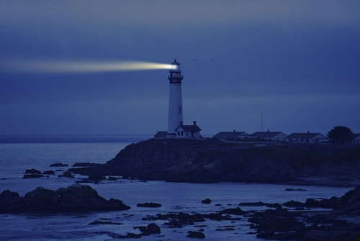
Light in the Dark

Slide 4
Light in the Dark
Noah
“… and did not spare the ancient world, but saved Noah, one of eight people, a preacher of righteousness, bringing in the flood on the world of the ungodly…” (2 Peter 2:5)
“Then the LORD saw that the wickedness of man was great in the earth, and that every intent of the thoughts of his heart was only evil continually.” (Genesis 6:5)
“But Noah found grace in the eyes of the LORD.” (Genesis 6:8)

Slide 5
Light in the Dark
Noah
Lot
“… and turning the cities of Sodom and Gomorrah into ashes, condemned them to destruction, making them an example to those who afterward would live ungodly; and delivered righteous Lot, who was oppressed by the filthy conduct of the wicked (for that righteous man, dwelling among them, tormented his righteous soul from day to day by seeing and hearing their lawless deeds)” (2 Peter 2:6-8)
Events of Genesis 19

Slide 6
Light in the Dark
Noah
Lot
Joseph
“The LORD was with Joseph, and he was a successful man; and he was in the house of his master the Egyptian. And his master saw that the LORD was with him and that the LORD made all he did to prosper in his hand.” (Genesis 39:2-3)

Slide 7
Light in the Dark
Noah
Lot
Joseph
“‘There is no one greater in this house than I, nor has he kept back anything from me but you, because you are his wife. How then can I do this great wickedness, and sin against God?’ So it was, as she spoke to Joseph day by day, that he did not heed her, to lie with her or to be with her. But it happened about this time, when Joseph went into the house to do his work, and none of the men of the house was inside, that she caught him by his garment, saying, ‘Lie with me.’ But he left his garment in her hand, and fled and ran outside.” (Genesis 39:9-12)

Slide 8
Light in the Dark
Noah
Lot
Joseph
David
“But the Spirit of the LORD departed from Saul, and a distressing spirit from the LORD troubled him. And Saul's servants said to him, ‘Surely, a distressing spirit from God is troubling you. Let our master now command your servants, who are before you, to seek out a man who is a skillful player on the harp. And it shall be that he will play it with his hand when the distressing spirit from God is upon you, and you shall be well.’” (1 Samuel 16:14-16)

Slide 9
Light in the Dark
Noah
Lot
Joseph
David
“And so it was, whenever the spirit from God was upon Saul, that David would take a harp and play it with his hand. Then Saul would become refreshed and well, and the distressing spirit would depart from him.” (1 Samuel 16:23)
David & Goliath – Genesis 17
Jonathan & Michal – Genesis 18

Slide 10
Light in the Dark
Noah
Lot
Joseph
David
“So David restrained his servants with these words, and did not allow them to rise against Saul. And Saul got up from the cave and went on his way.” (1 Samuel 24:7)
“But David said to Abishai, ‘Do not destroy him; for who can stretch out his hand against the LORD's anointed, and be guiltless?’” (1 Samuel 26:9)
“Then David lamented with this lamentation over Saul and over Jonathan his son …” (2 Samuel 1:17)

Slide 11
Light in the Dark
Noah
Lot
Joseph
David
Daniel
“But Daniel purposed in his heart that he would not defile himself with the portion of the king's delicacies, nor with the wine which he drank; therefore he requested of the chief of the eunuchs that he might not defile himself.” (Daniel 1:8)

Slide 12
Light in the Dark
Noah
Lot
Joseph
David
Daniel
Christians
“Therefore those who were scattered went everywhere preaching the word.” (Acts 8:4)
“Do not fear any of those things which you are about to suffer. Indeed, the devil is about to throw some of you into prison, that you may be tested, and you will have tribulation ten days. Be faithful until death, and I will give you the crown of life.” (Revelation 2:10)

Slide 13
Light in the Dark
Does your light shine through the darkness?

