Slide 1
Christian Communication #6

Slide 2
Can You Hear Me Now?
Being A Good Listener

Slide 3
Can You Hear Me Now?
Are you a good listener when others are trying to communicate with you?

Slide 4
Can You Hear Me Now?
“Let nothing be done through selfish ambition or conceit, but in lowliness of mind let each esteem others better than himself. Let each of you look out not only for his own interests, but also for the interests of others.” (Philippians 2:3-4)
With Love

Slide 5
Can You Hear Me Now?
“Love suffers long and is kind; love does not envy; love does not parade itself, is not puffed up; does not behave rudely, does not seek its own, is not provoked, thinks no evil; does not rejoice in iniquity, but rejoices in the truth; bears all things, believes all things, hopes all things, endures all things.” (1 Corinthians 13:4-7)
With Love

Slide 6
Can You Hear Me Now?
“So then, my beloved brethren, let every man be swift to hear, slow to speak, slow to wrath; for the wrath of man does not produce the righteousness of God.” (James 1:19-20)
“I, therefore, the prisoner of the Lord, beseech you to walk worthy of the calling with which you were called, with all lowliness and gentleness, with longsuffering, bearing with one another in love, endeavoring to keep the unity of the Spirit in the bond of peace.” (Ephesians 4:1-3)
With Love
With Patience

Slide 7
Can You Hear Me Now?
“Therefore comfort each other and edify one another, just as you also are doing.” (1 Thessalonians 5:11)
“But whoever has this world's goods, and sees his brother in need, and shuts up his heart from him, how does the love of God abide in him?” (1 John 3:17)
“Confess your trespasses to one another, and pray for one another, that you may be healed. The effective, fervent prayer of a righteous man avails much.” (James 5:16)
With Love
With Patience
Helpful

Slide 8
Can You Hear Me Now?
“When He had called the multitude to Himself, He said to them, "Hear and understand …” (Matthew 15:10)
“Husbands, likewise, dwell with them with understanding, giving honor to the wife, as to the weaker vessel, and as being heirs together of the grace of life, that your prayers may not be hindered.” (1 Peter 3:7)
With Love
With Patience
Helpful
Understanding

Slide 9
Can You Hear Me Now?
Are you a good listener to the word of God?

Slide 10
Can You Hear Me Now?
“… of whom we have much to say, and hard to explain, since you have become dull of hearing.” (Hebrews 5:9-11)
“Make the heart of this people dull, And their ears heavy, And shut their eyes; Lest they see with their eyes, And hear with their ears, And understand with their heart, And return and be healed.”(Isaiah 6:10)
Dull Ears

Slide 11
Can You Hear Me Now?
“For the time will come when they will not endure sound doctrine, but according to their own desires, because they have itching ears, they will heap up for themselves teachers; and they will turn their ears away from the truth, and be turned aside to fables.” (2 Timothy 4:3-4)
Dull Ears
Itching Ears

Slide 12
Can You Hear Me Now?
“But the ones that fell on the good ground are those who, having heard the word with a noble and good heart, keep it and bear fruit with patience.” (Luke 8:15)
Dull Ears
Itching Ears
Honest & Good

Slide 13
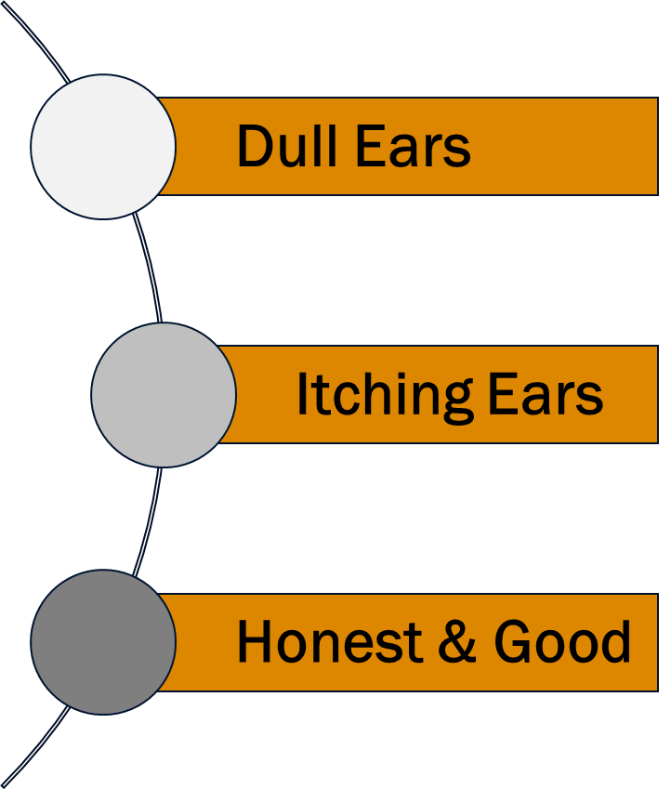
Can You Hear Me Now?
With Love
With Patience
Helpful
Understanding

